Slide 1
Welcome
Hari Polnati

Slide 2
Concurrency
Day1:

Slide 3
Agenda
Basics of Concurrency
Thread
Process
Using Threads (Thread API)
Daemon Threads
Lifecycle and Thread States
Sleeping, Joining and interrupting threads
Race conditions
Synchronization
Monitors and structured locking
The Volatile keyword
Thread Local
Advance Concurrency API’s
Unstructured locks
Executor service
Thread pool and types
Callables and Features (Completable Feature)
Semaphores
ForkJoin

Slide 4
What is Thread
Single sequential flow control
An independent sequential execution of a program
Sequential program instructions that can be executed independently
Allows the program split into simultaneously tasks

Slide 5

Let's understand with an example
I want to Building A Wall
1.Get Cement
2.Add a layer of cement on top of built wall
3.Get Brick
4.Firmly place brick on layer of mortar
5.Loop (Keep repeat)

Slide 6
One Builder
Let’s imagine only one person/builder/machine is doing this
1.Get Cement
2.Add a layer of cement on top of built wall
3.Get Brick
4.Firmly place brick on layer of mortar
5.Loop back (Keep repeat)

Slide 7

Multiple Builders
Each builder is working on these same instructions is a “Thread”

Slide 8
What is Process
Application/program/App software
Running an application - OS will do below
load program to memory
Allocate resources to program run
“Execute” the program -> Process (run state of an app)

Slide 9
Requirement
A process need some instructions to run in parallel (not sequential)

Slide 10
Solution
Threads
Unit execution of with in a process
Usually has a shared object
Has shared resources like memory, heap storage
Does the work of the process

Slide 11
Process can be
Single threaded -> All instructions executed in sequentially
or
Multithread also -> can spawn into multiple threads that can run in parallel

Slide 12
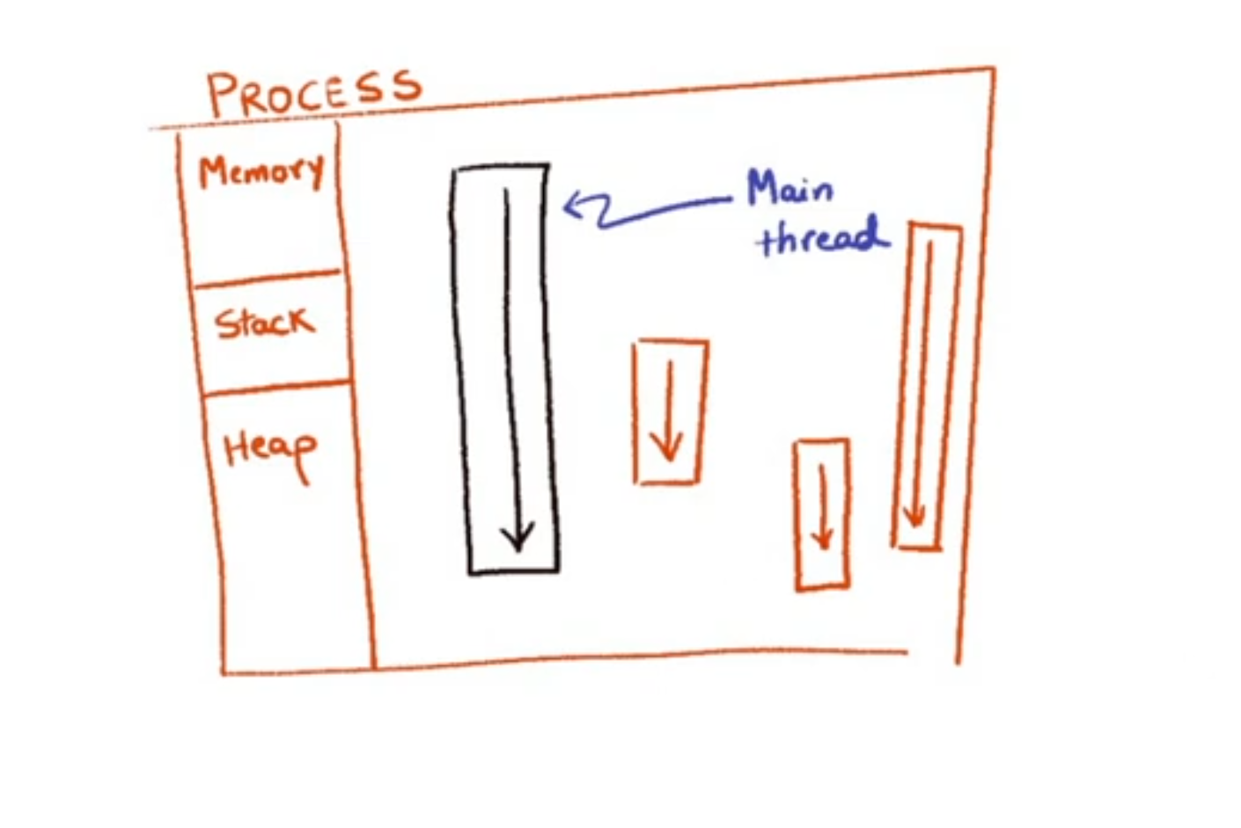
Process with Multiple threads

Slide 13
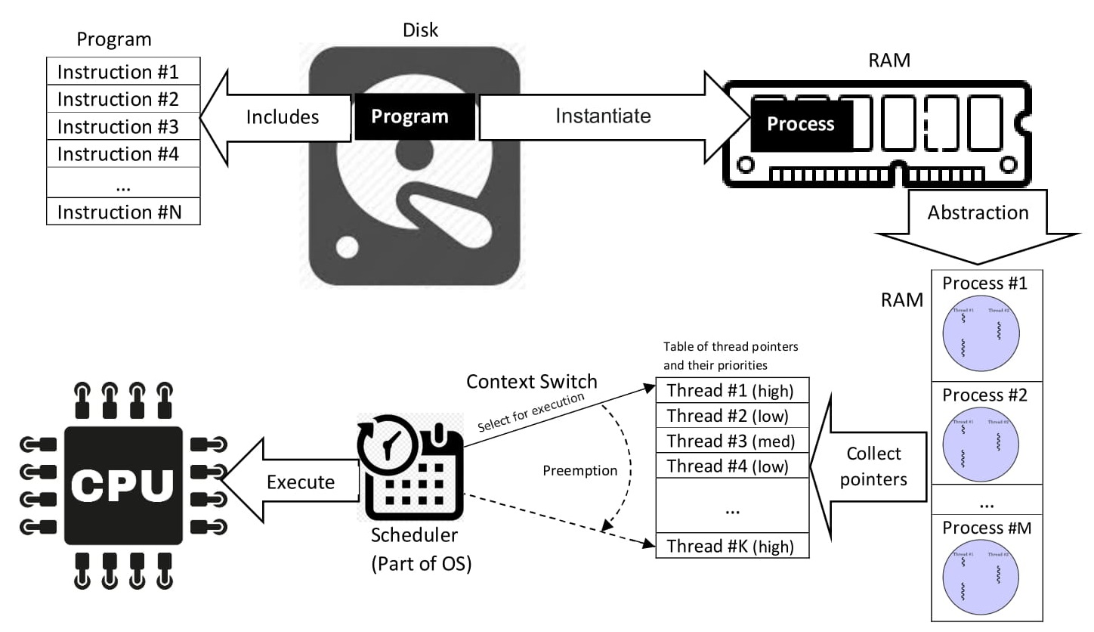
Source: https://en.wikipedia.org/wiki/Process_(computing)

Slide 14
A Java Application
A single process (JVM)
Consists of various threads – Garbage Collector, Security Manager, …
Single Application Thread – responsible for running main method

Slide 15
Single Application Thread
Need more threads
How to created using language api ?

Slide 16
Java language api allow us to create threads using called
Extends Thread class
Implements Runnable Interface
Something that can be run
Has run method

Slide 17
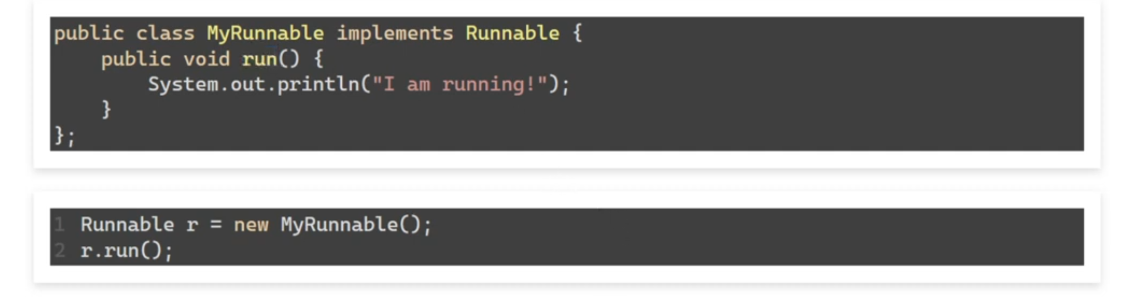
Approach1. Runnable
Using Runnable directly

Slide 18
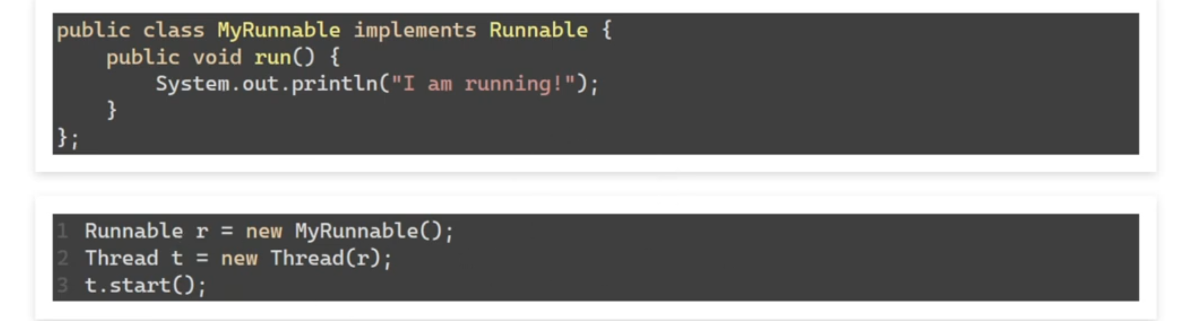
If we want to run in separate Thread

Slide 19
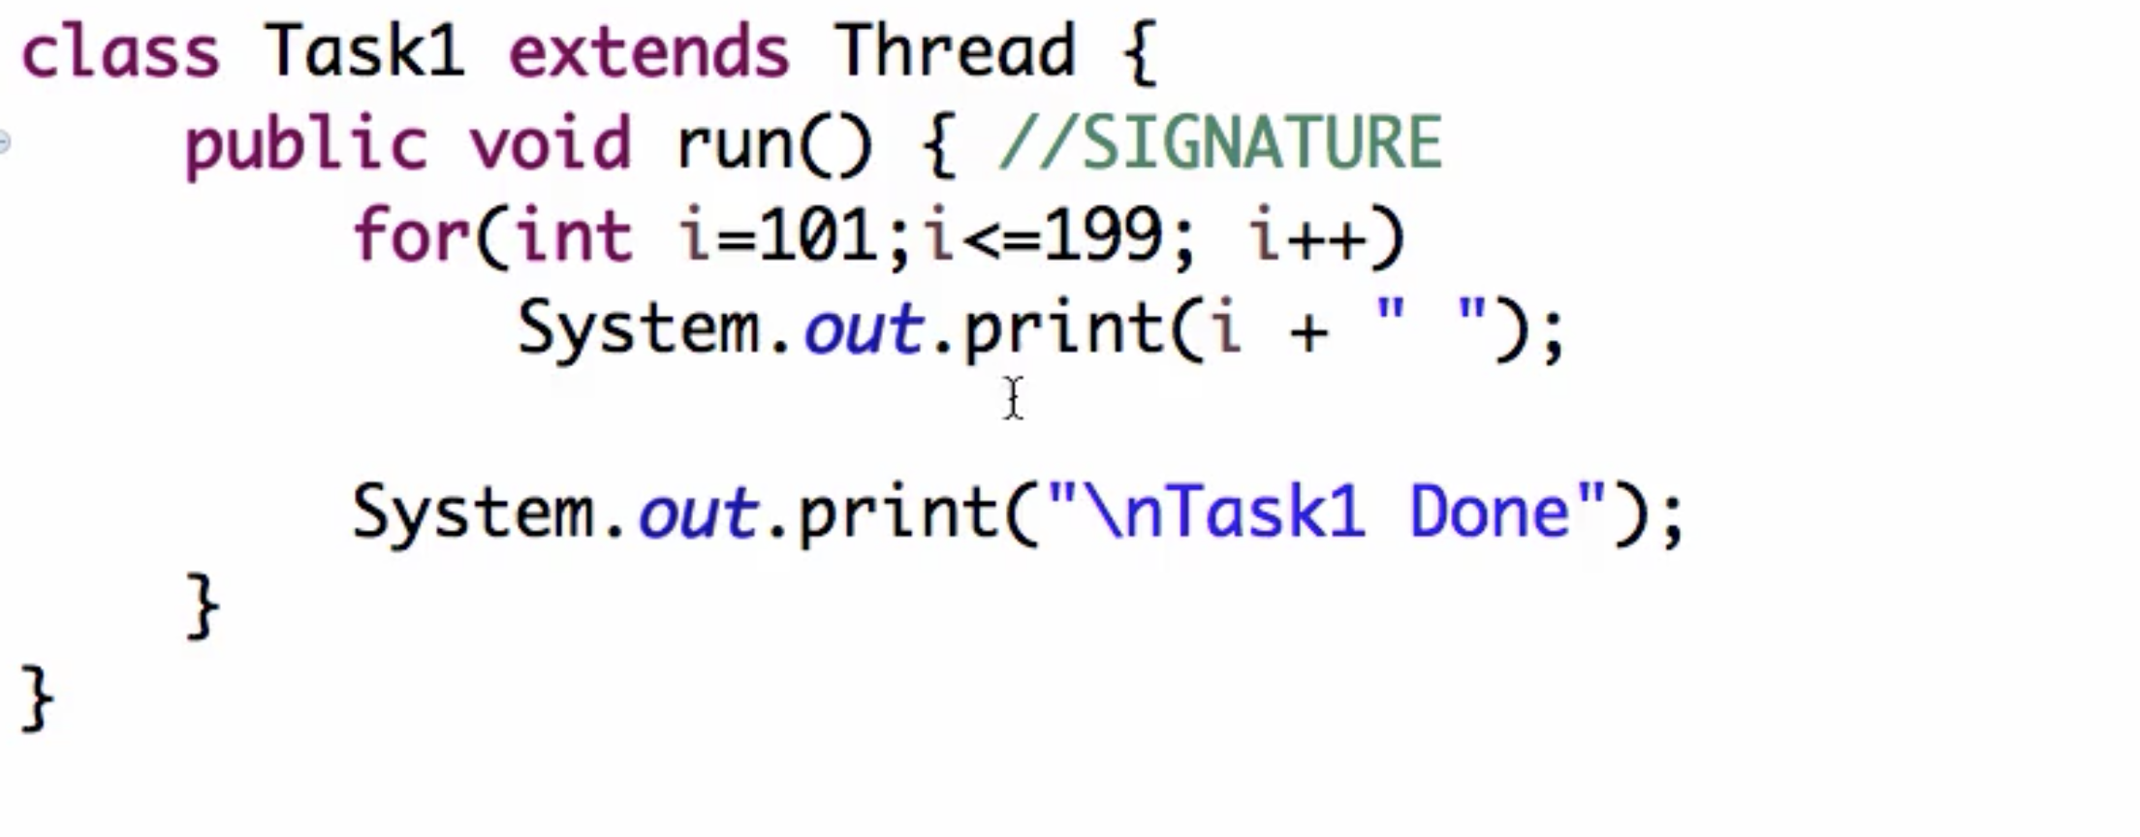
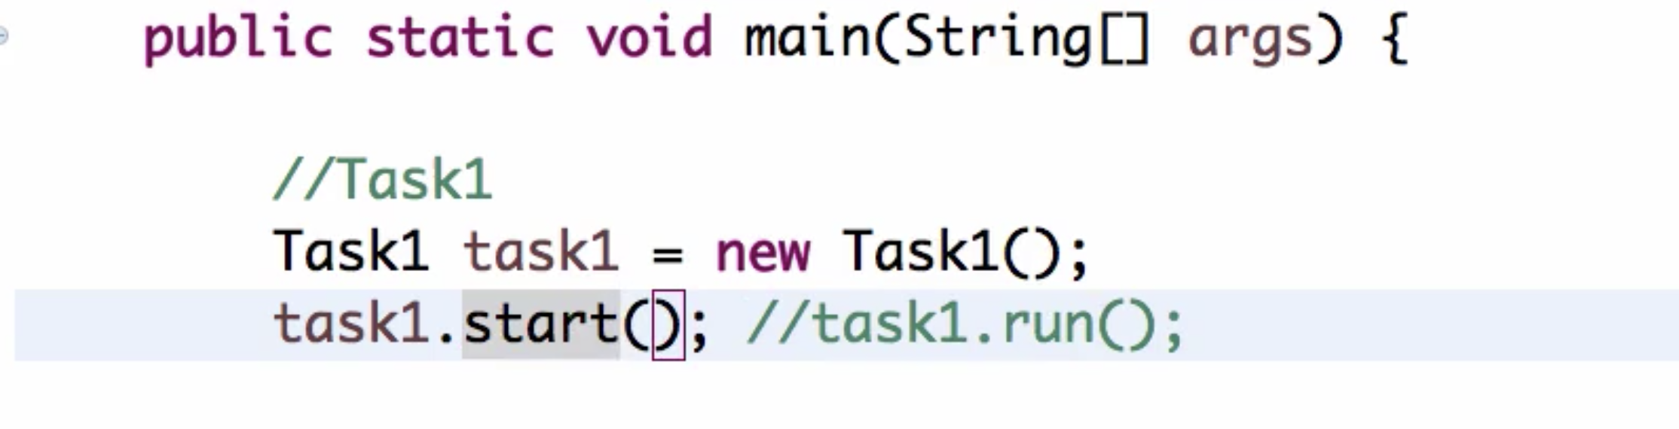
Approach2. Thread Class
}

Slide 20
How this works ?
JVM calls underlying OS threading API

Slide 21
When does a thread end?
When run() method execution completed
When run() method throws exception

Slide 22
Practical usage
Day2:
Application – build prime numbers
Calculate nth Prime number

Slide 23
Requirement
Calculate nth Prime number
Get user input for n
Calculate nth prime number
Repeat
Quit if user enter input(n) is zero 0

Slide 24
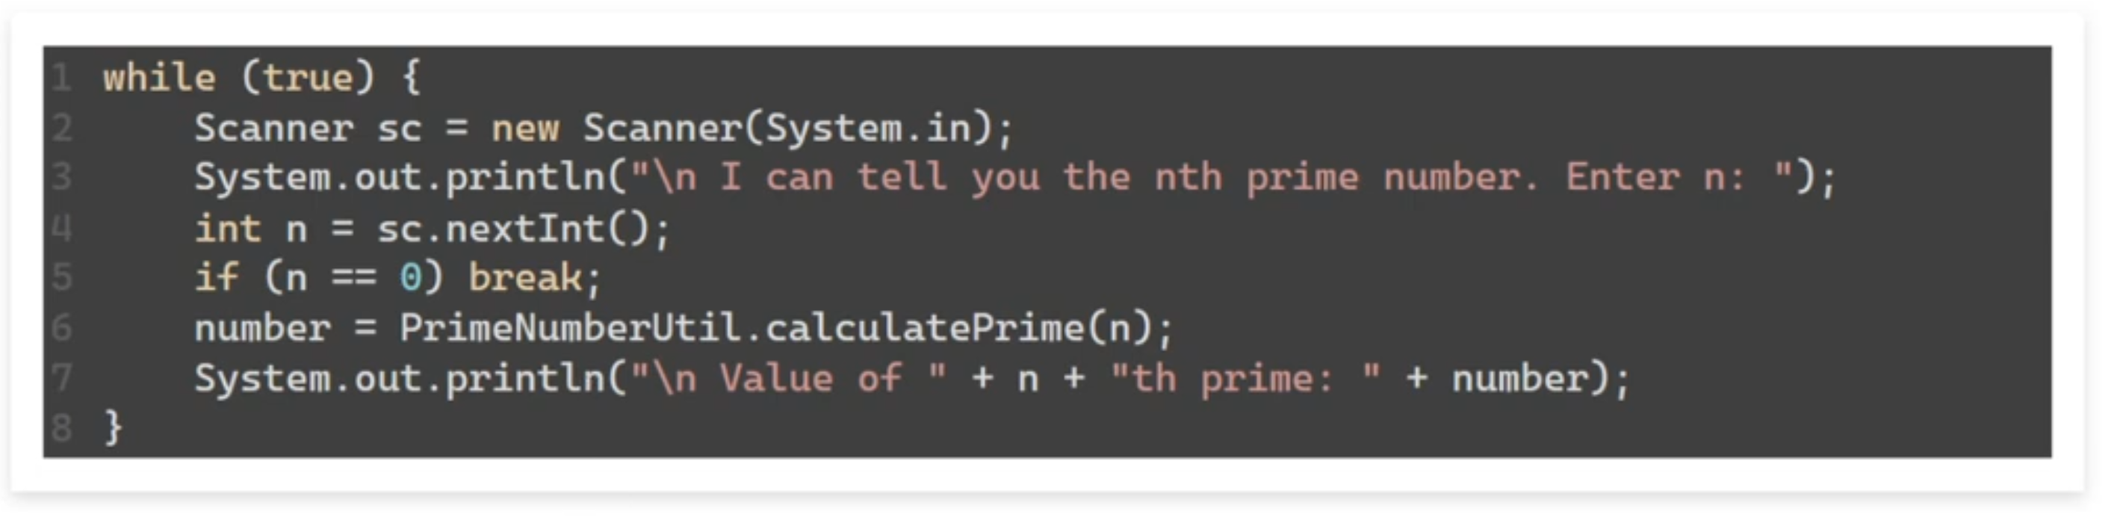

Slide 25
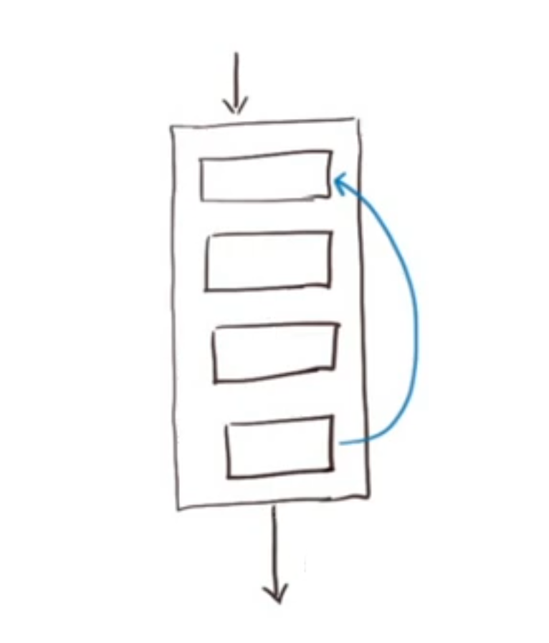
Thread Diagram

Slide 26
Long calculation blocks
Each computation happens in a separate thread

Slide 27
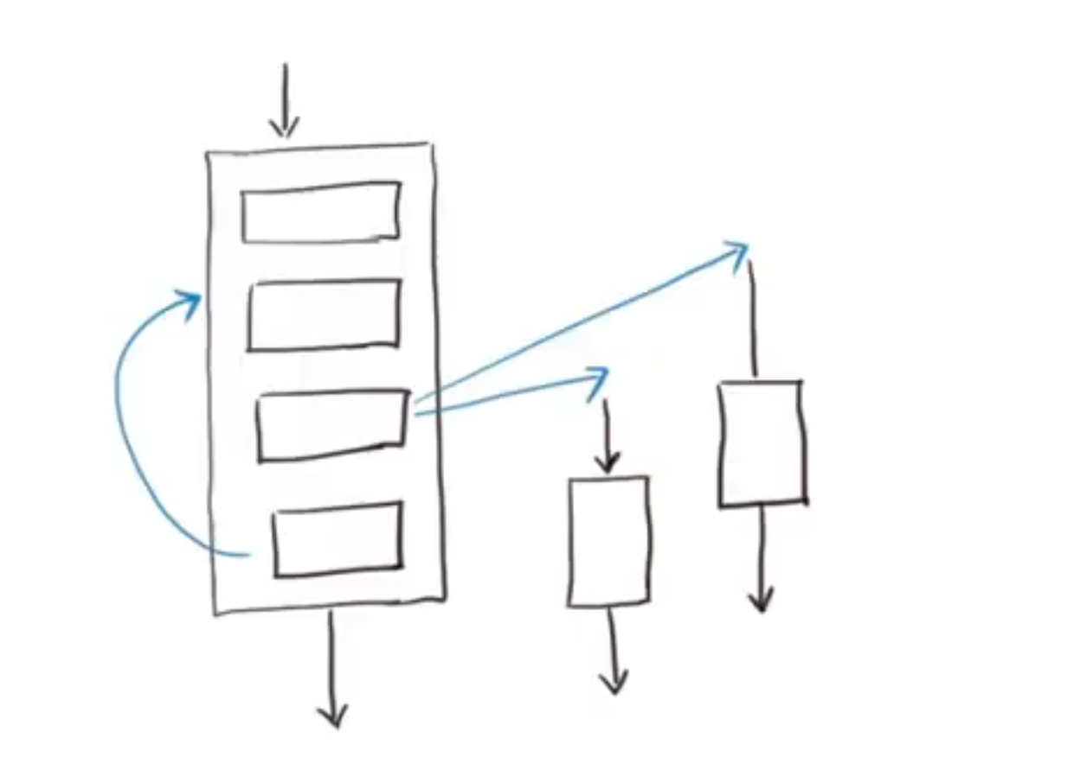
Ideal Thread Diagram

Slide 28
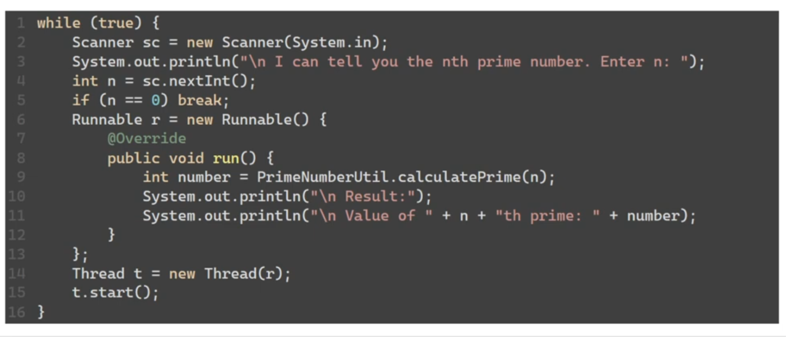

Slide 29
Daemon Threads
When does Application ends?
If you are not using concurrency -> when the main method thread ends
If you are using concurrency, When the last thread ends.

Slide 30
Two types of Threads
User Threads
Application Thread/main thread
new Thread(runnable).start();
Daemon Threads

Slide 31
When does java application ends in multithread model
When all user threads have exited

Slide 32
What if you don’t want the application exit to wait for a thread.
Daemon Thread
Thread th = new Thread(runnable)
th.setDaemon(true);
th.start();

Slide 33
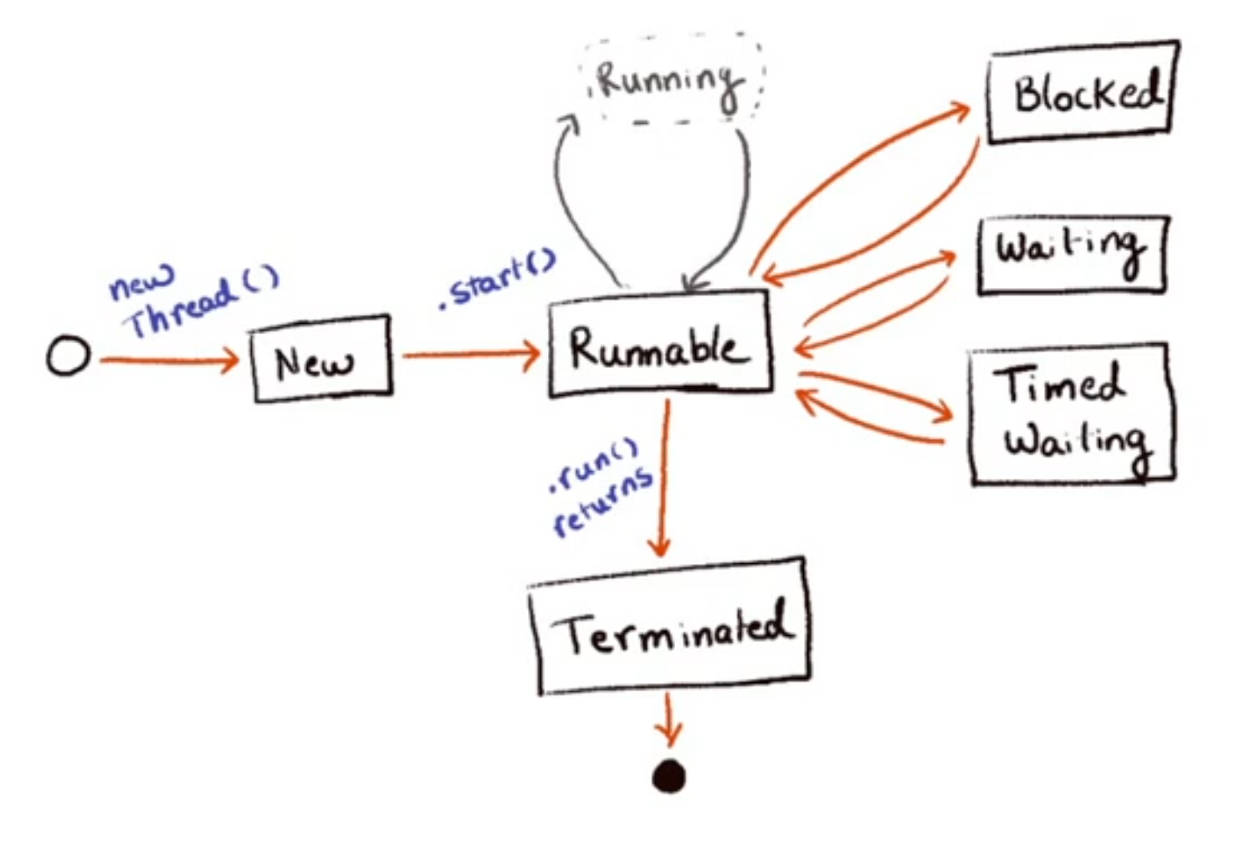
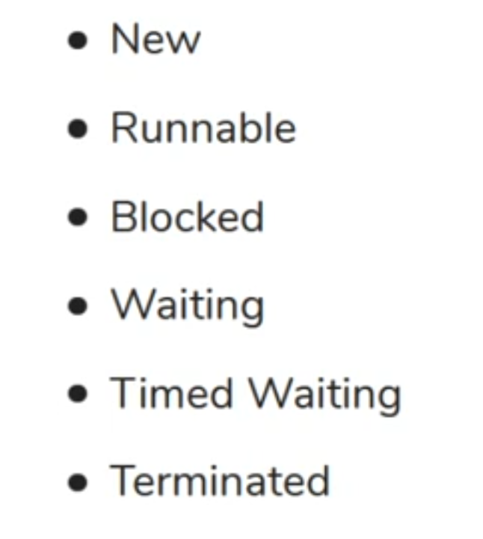
Thread LifeCycle and States
https://docs.oracle.com/javase/8/docs/api/java/lang/Thread.State.html

Slide 34
Thread Sleep
Day3:
pausing or waiting for a thread
Static method : Thread.sleep(millisecs)

Slide 35
Joining Threads
One thread depends on another thread
What if we need to wait
Use case: Print a message after the last thread ends

Slide 36
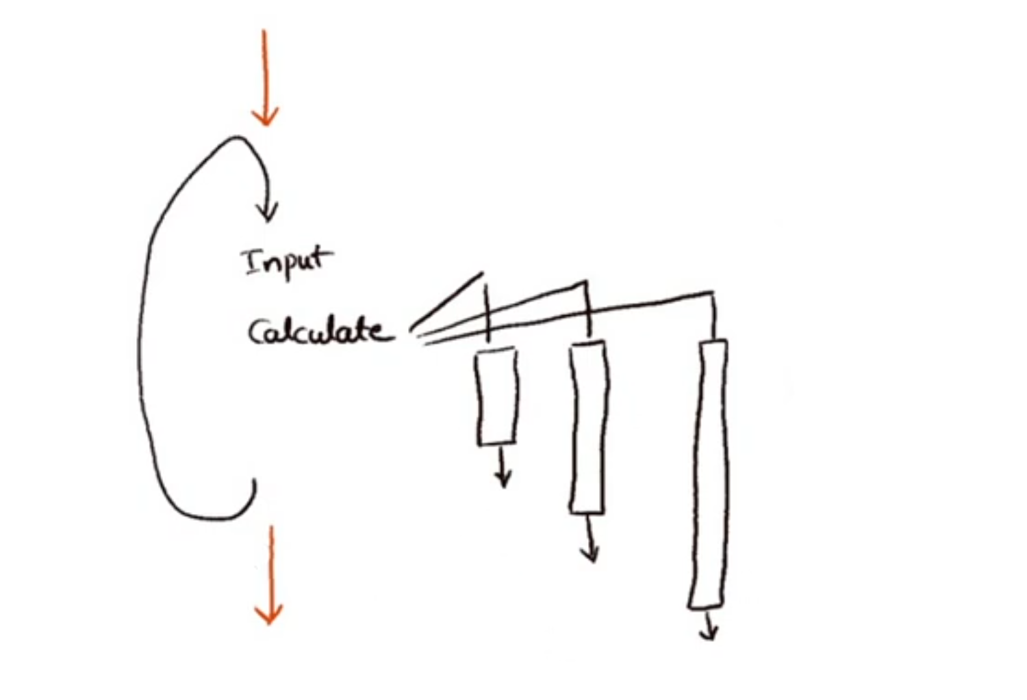
Do something after the last thread completes

Slide 37
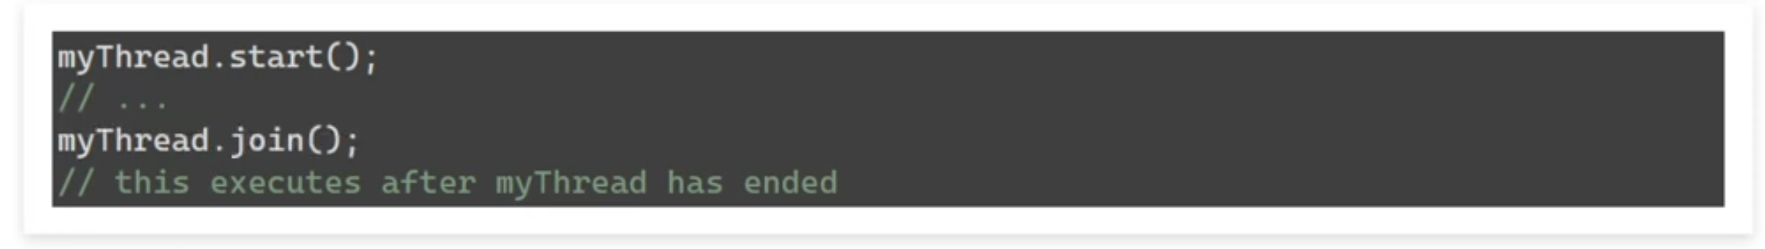
Join
“joins” a certain thread with the currently running thread
Barrier synchronization

Slide 38
Stop Thread
Interrupt()

Slide 39
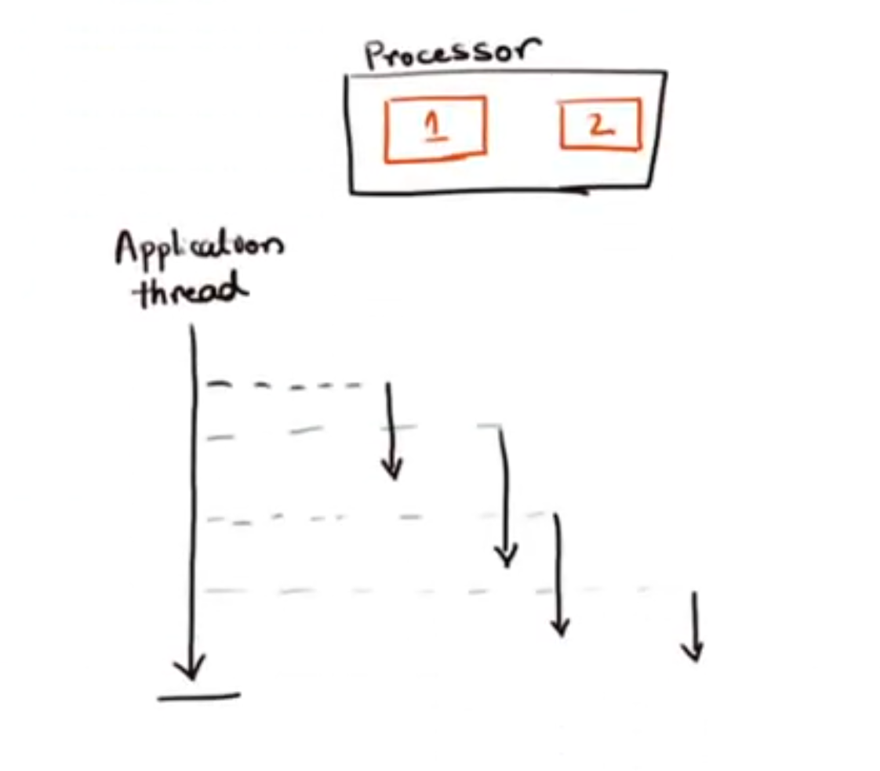
Concurrency vs Parallelism
Let’s Assume a dual core processor

Slide 40


Parallelism
Concurrency
Two threads running on two cores
Running many diff tasks at the same time
By definition we need multiple cores
Ten threads running on two cores
Multiple tasks are in progress at same time
Can be done with single/multi core CPUs

Slide 41
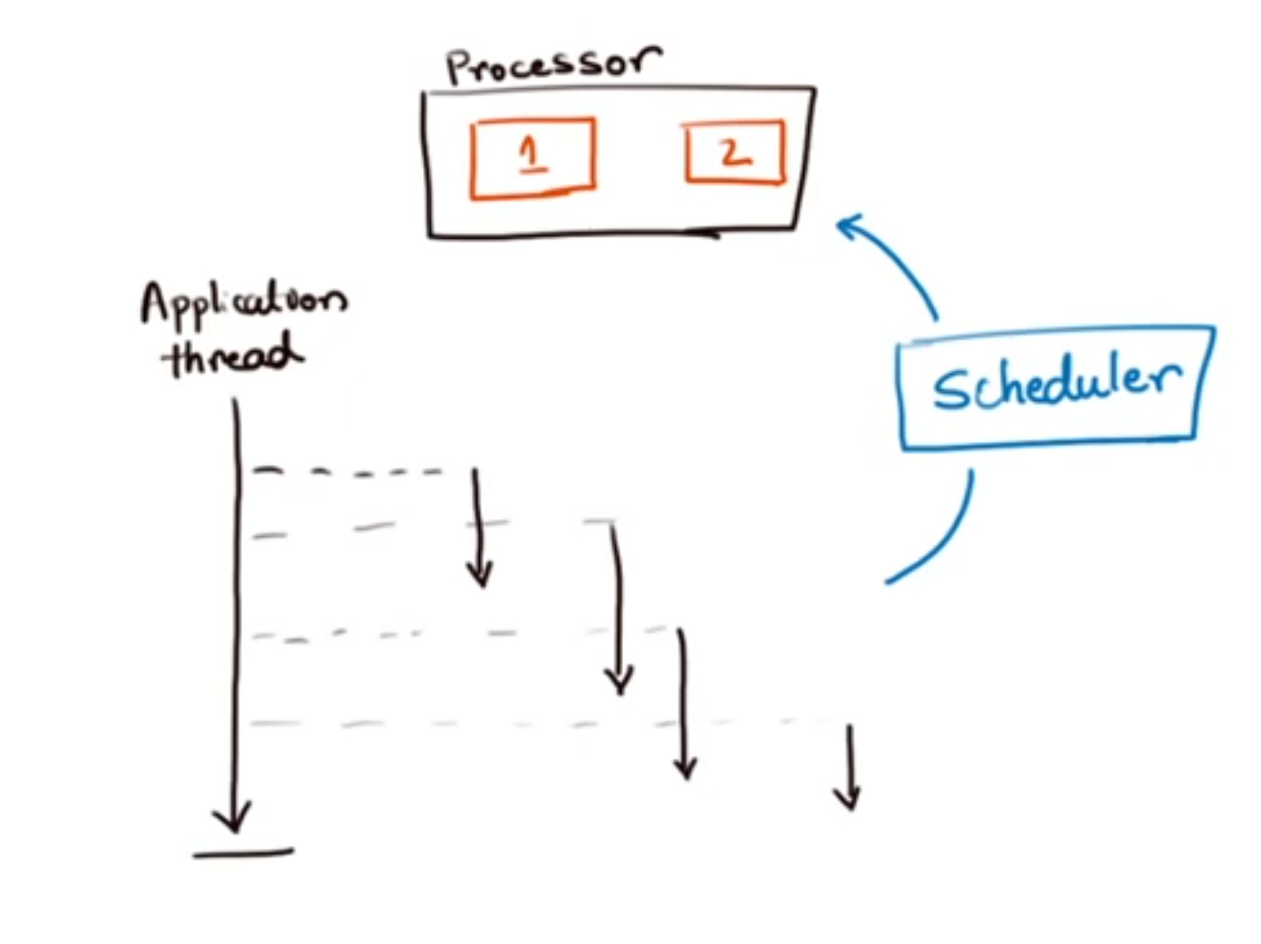
Scheduler
Operation system process
Responsible for scheduling a thread to an available processor core

Slide 42
Need of Synchronization

Slide 43
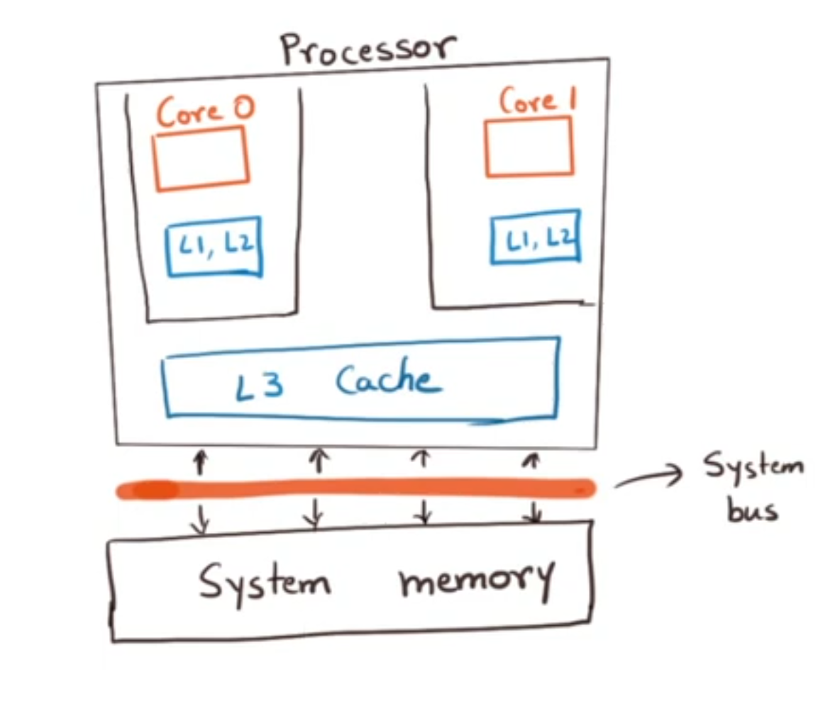
Processor Cores with cache
Threads don’t shared data – No problem
Threads share constant data – No problem
Threads read and write to same data – Its is a problem

Slide 44
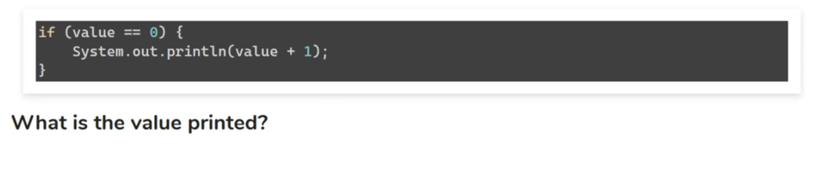
Two Race Condition Patterns
Example 1:

Slide 45
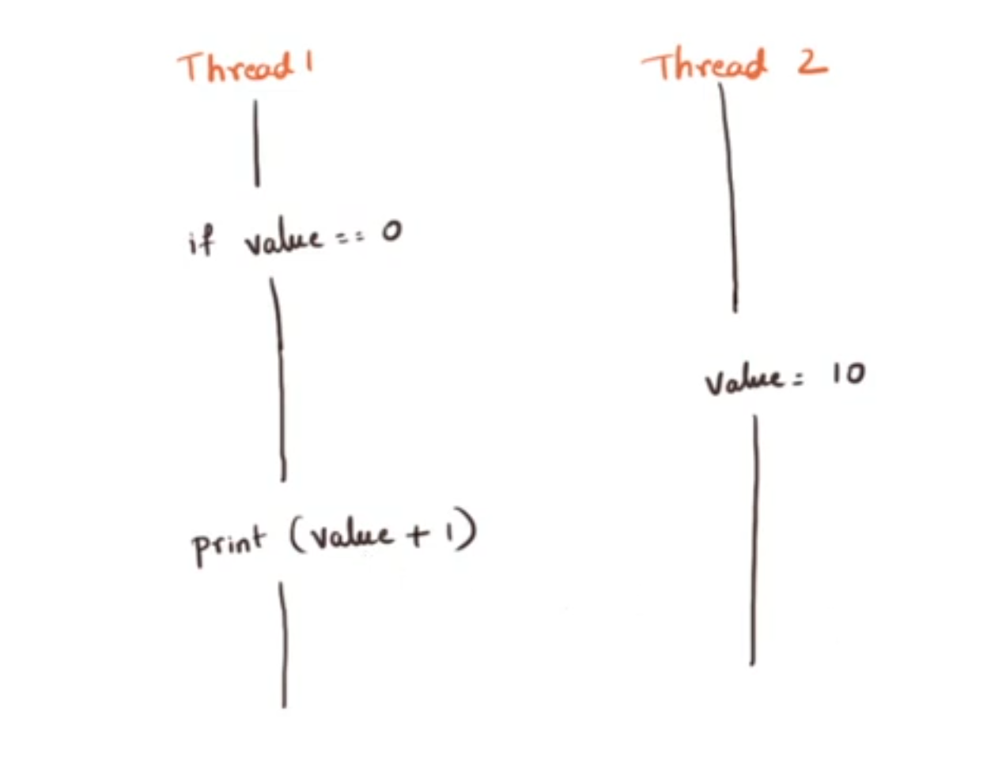
Check-then-act pattern

Slide 46
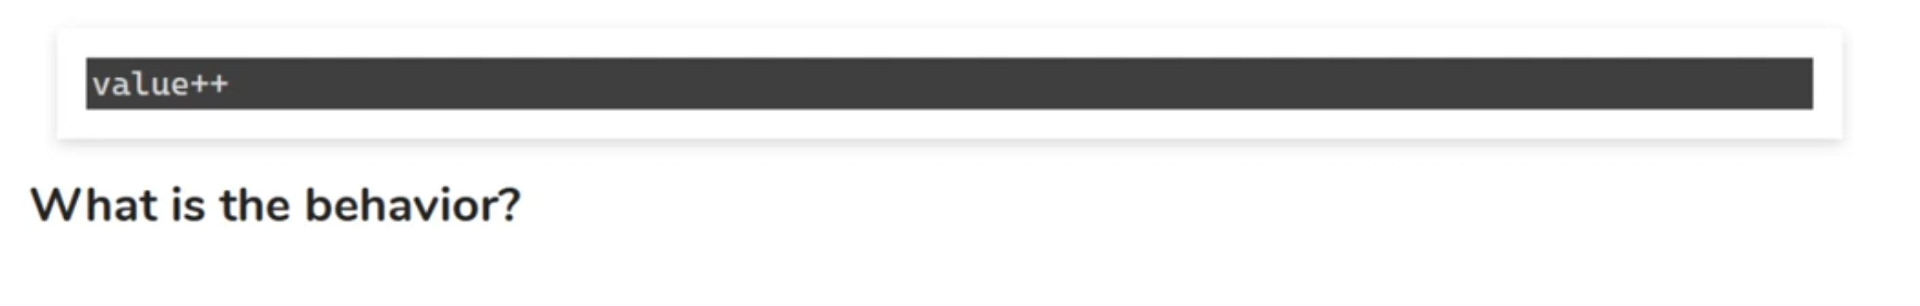
Example 2:

Slide 47
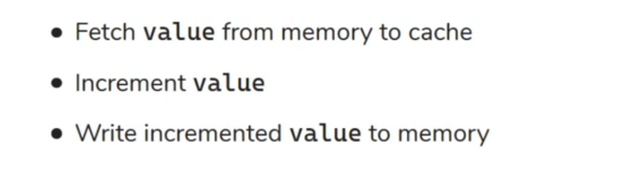

Slide 48
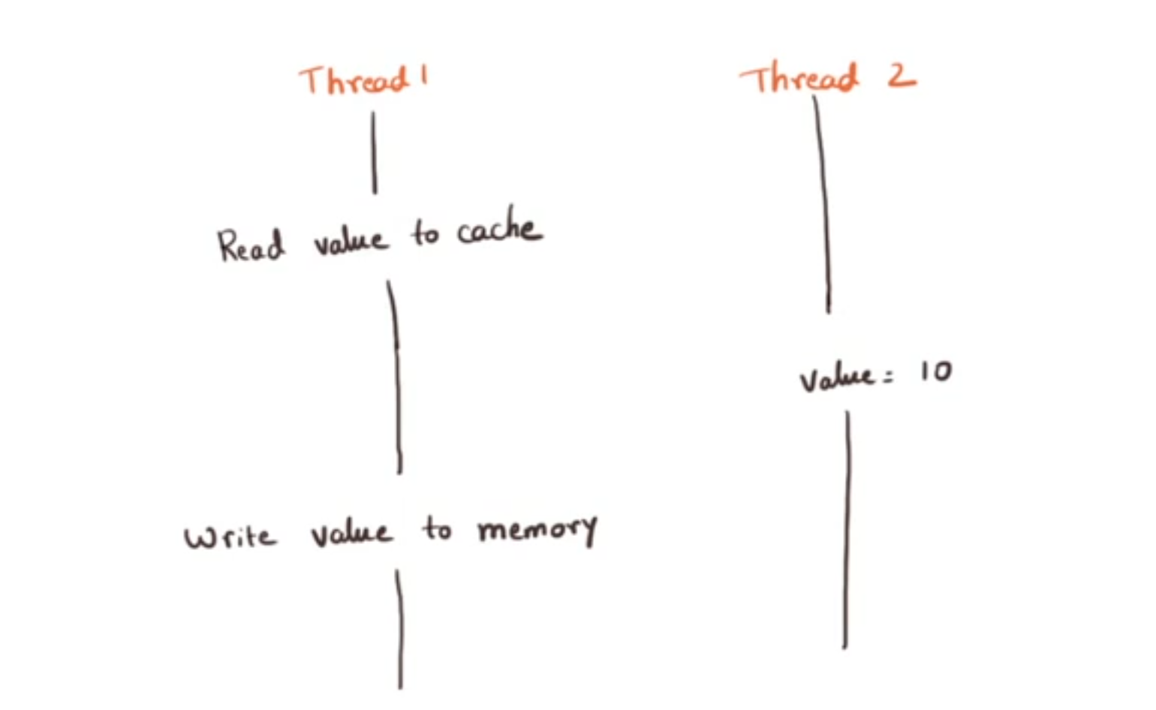
Read-modify-write

Slide 49
How do we solve Race conditions?

Slide 50

Solving Race conditions
Sol1: Make sure only one thread can “pick up” a data element
Lock and key model
Coordinating the access

Slide 51
Synchronization
Make sure two threads don’t simultaneously access a critical element
Control data not code
JVM feature
Real time Examples:
One professor is taking a lecture. Another professor cannot enter and teach at the exact same time. He/she has to wait to teach till the first professor leaves the Classroom. After first professor leaves the class, the second professor can enter and teach the subject and leave after a specific period of time. The lectures are synchronised one after another and for a specific period of time
Consider a Joint bank account has two account holders namely X and Y . Assume 1000rs the balance the account, if both X and Y try to withdraw 1000rs there’s state where neither X nor Y can withdraw money . Hence there’s lock applied on the bank account when a the first person transaction is carried out. When X withdraws money Y should wait until the transaction is done.

Slide 53
Day4:
What synchronization achieves
Mutual exclusion (Mutex)
Visibility –
Value is read from memory before block execution
Value is written to memory after execution completes

Slide 54
Structured lock
Synchronization block or synchronized method is referred as structured lock
Block structure using synchronized.
Acquiring and releasing lock are implicit – JVM will take care
Benefits:
Exception causing control to exit: lock will auto release

Slide 55
How to handle concurrency issues?
Don’t have shared data
Share only immutable values
Use Synchronization
If we do either one of three above options, then code is thread safe.

Slide 56
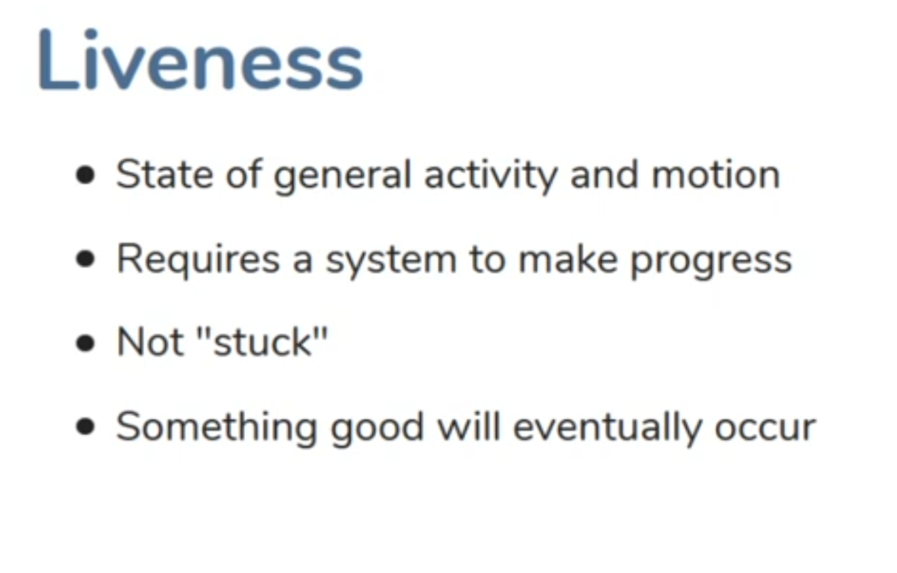
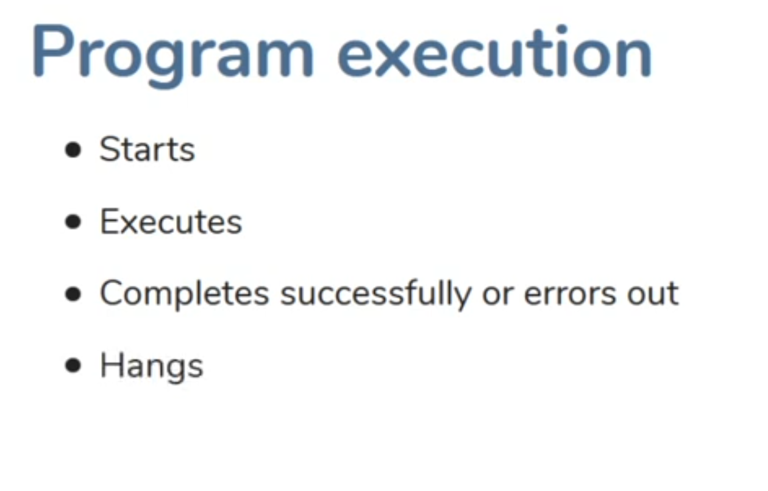
Liveness
Deadlocks, livelocks and startvation
1
2

Slide 57
What causes liveness issues ?
The infinite loop – without concurrency
Deadlock, Livelock and Starvation – with concurrency

Slide 58
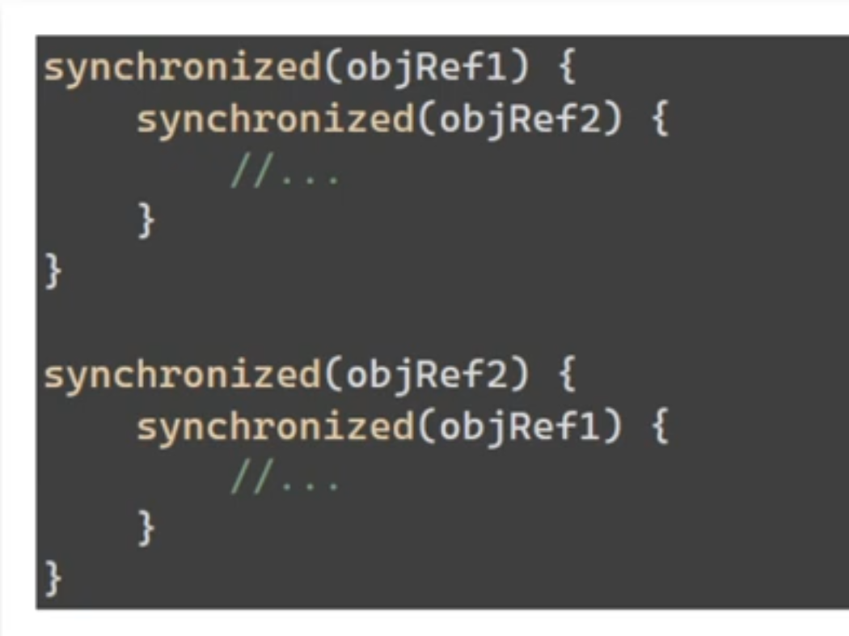
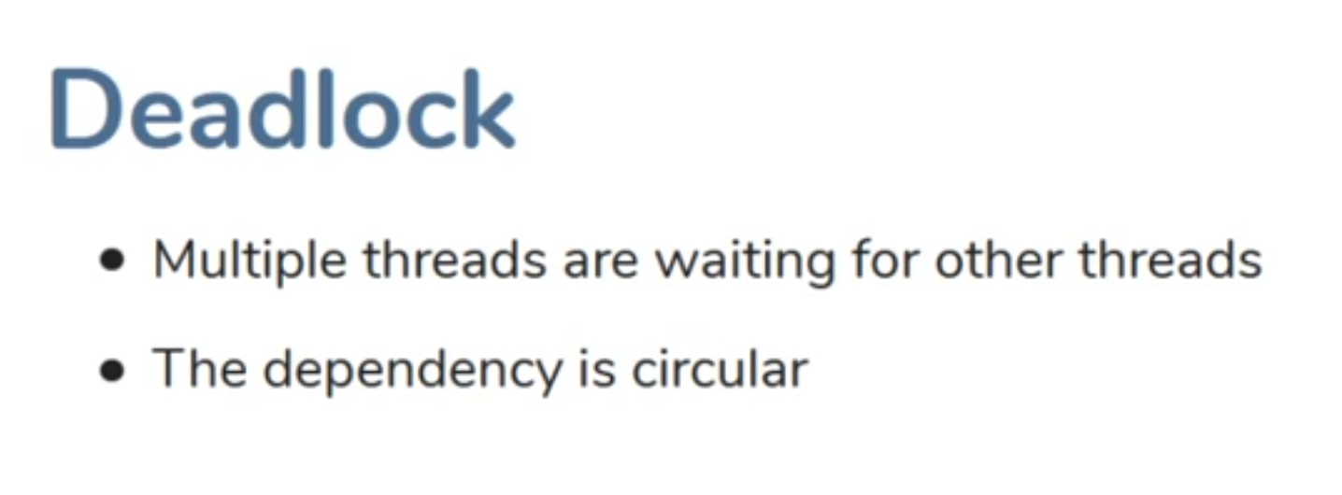

T1 - Obj1 Obj2?
T2 - Obj2 Obj1?
Result: Potentially threads are waiting forever

Slide 59

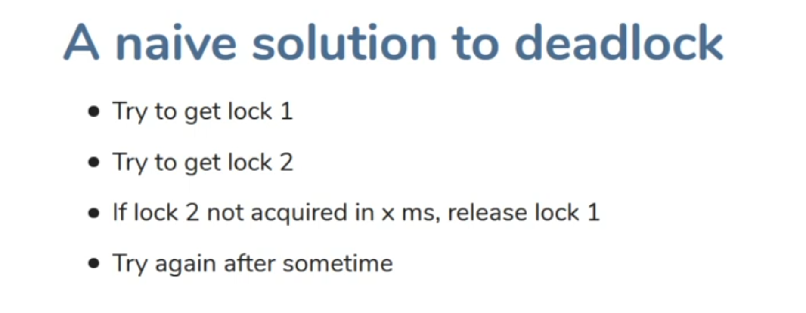
Example: Two people each other in corridor and both move aside to let the other pass

Slide 60

Low priority thread not scheduled by the executor
Example: Actor or Sports person never get a chance to play

Slide 61
How do we avoid these Liveness problems ?
No Java/JVM feature to avoid these
Careful usage of locks

Slide 62
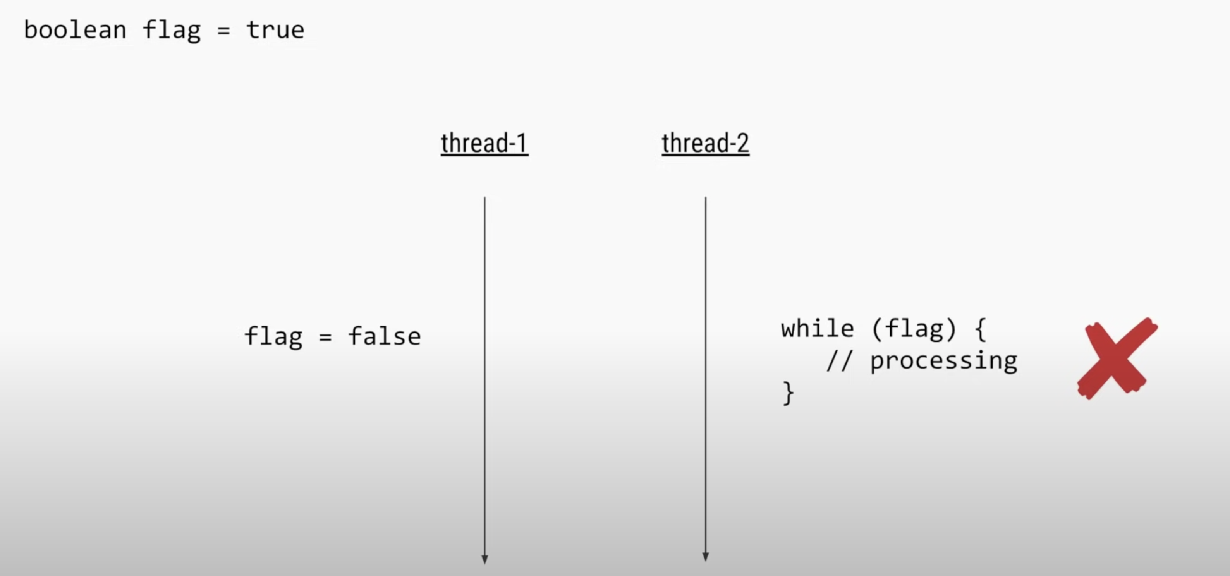
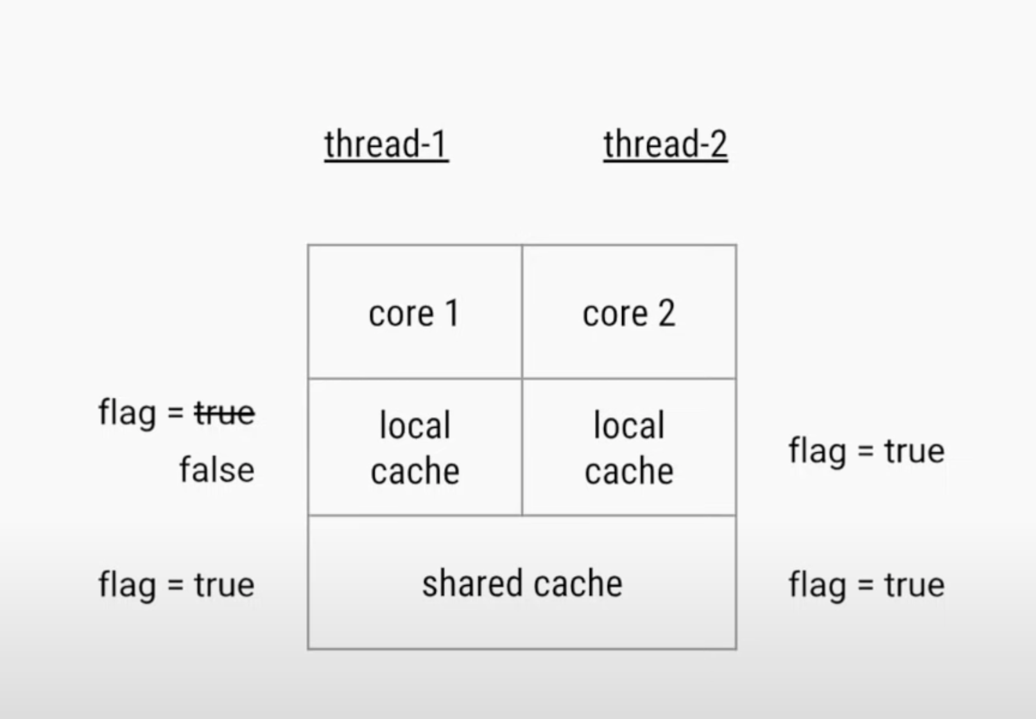
Visibility Problem

Slide 63
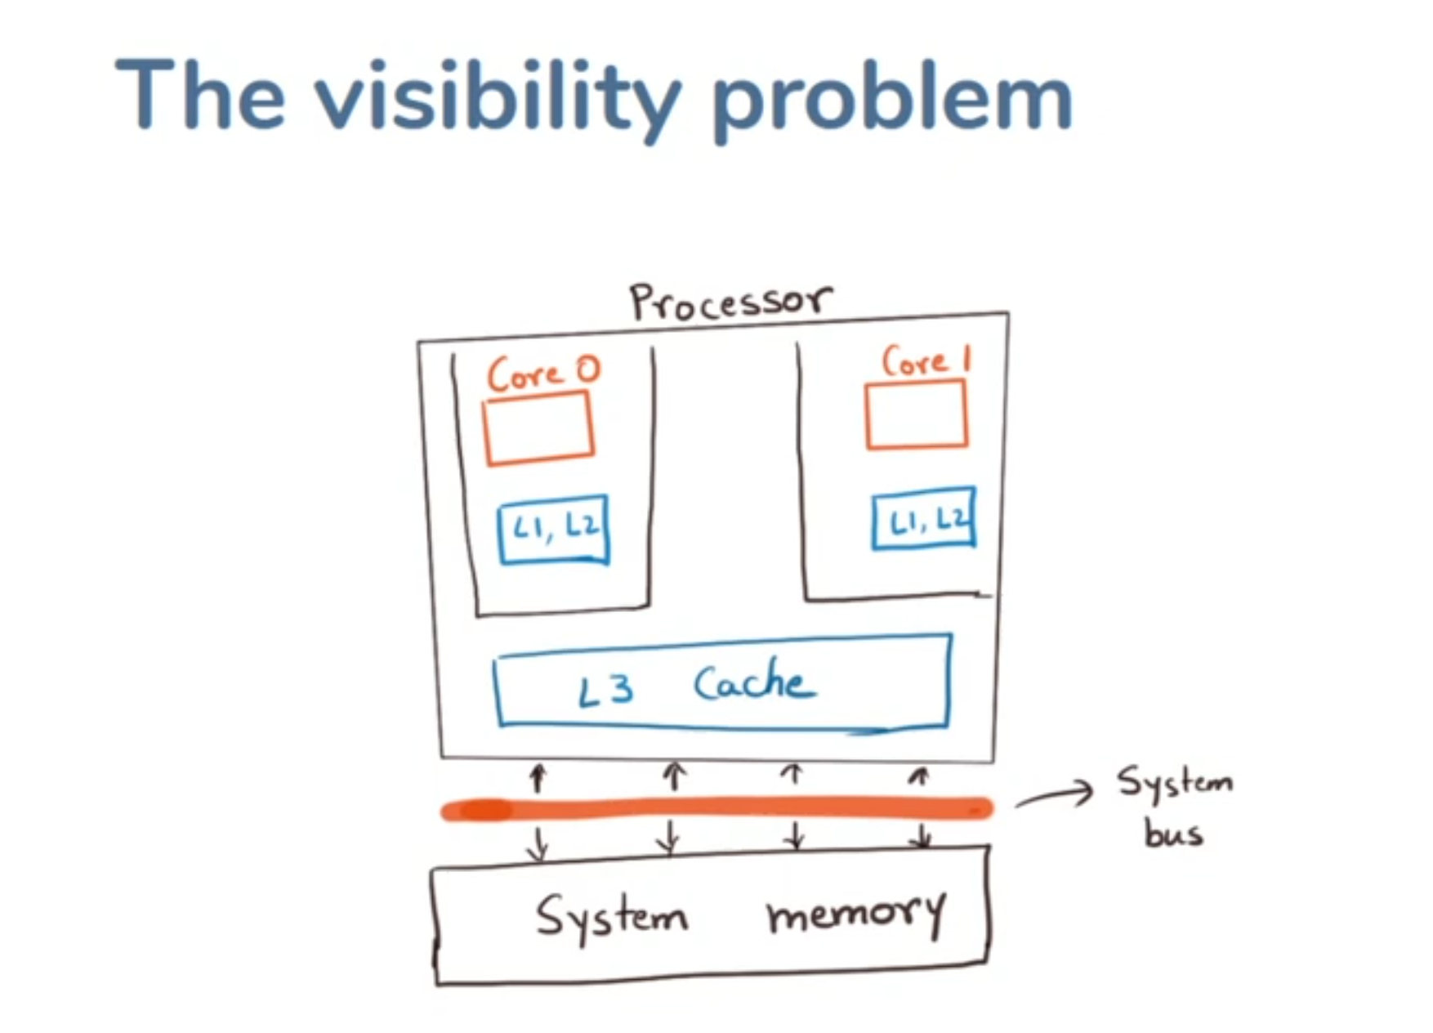
The Volatile keyword Marks a variable as don’t cache Always read/write from/to main memory
Fixes the problem using synchronization
Requirement :
Data should be visible by other threads before end of synchronization block/method
You no need to care of mutual exclusion and only worry about visability

Slide 64
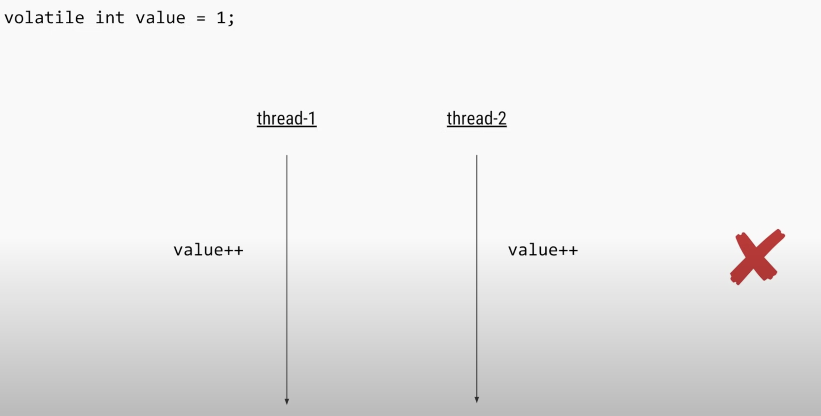
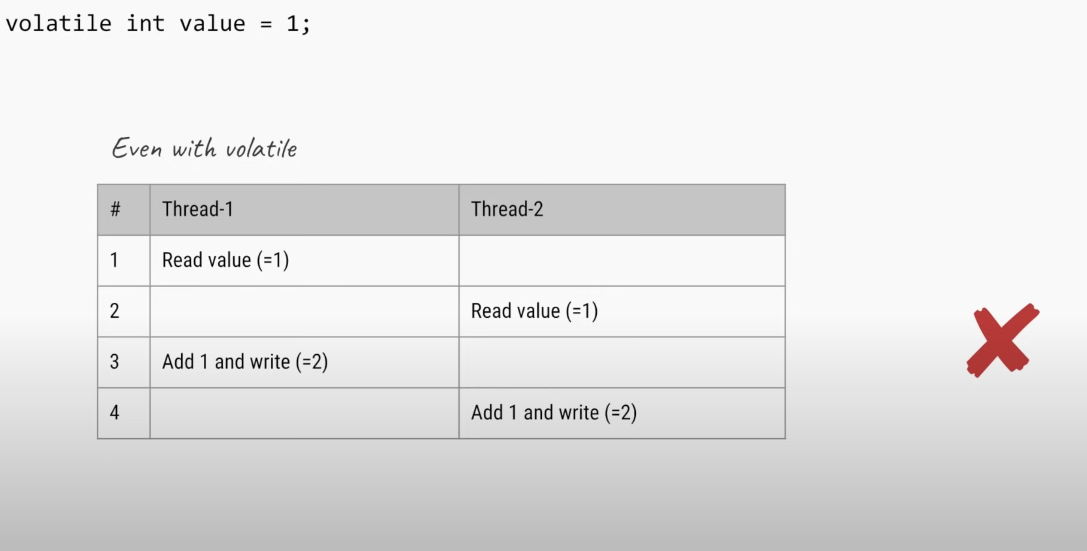
Synchronization Problem

Slide 65
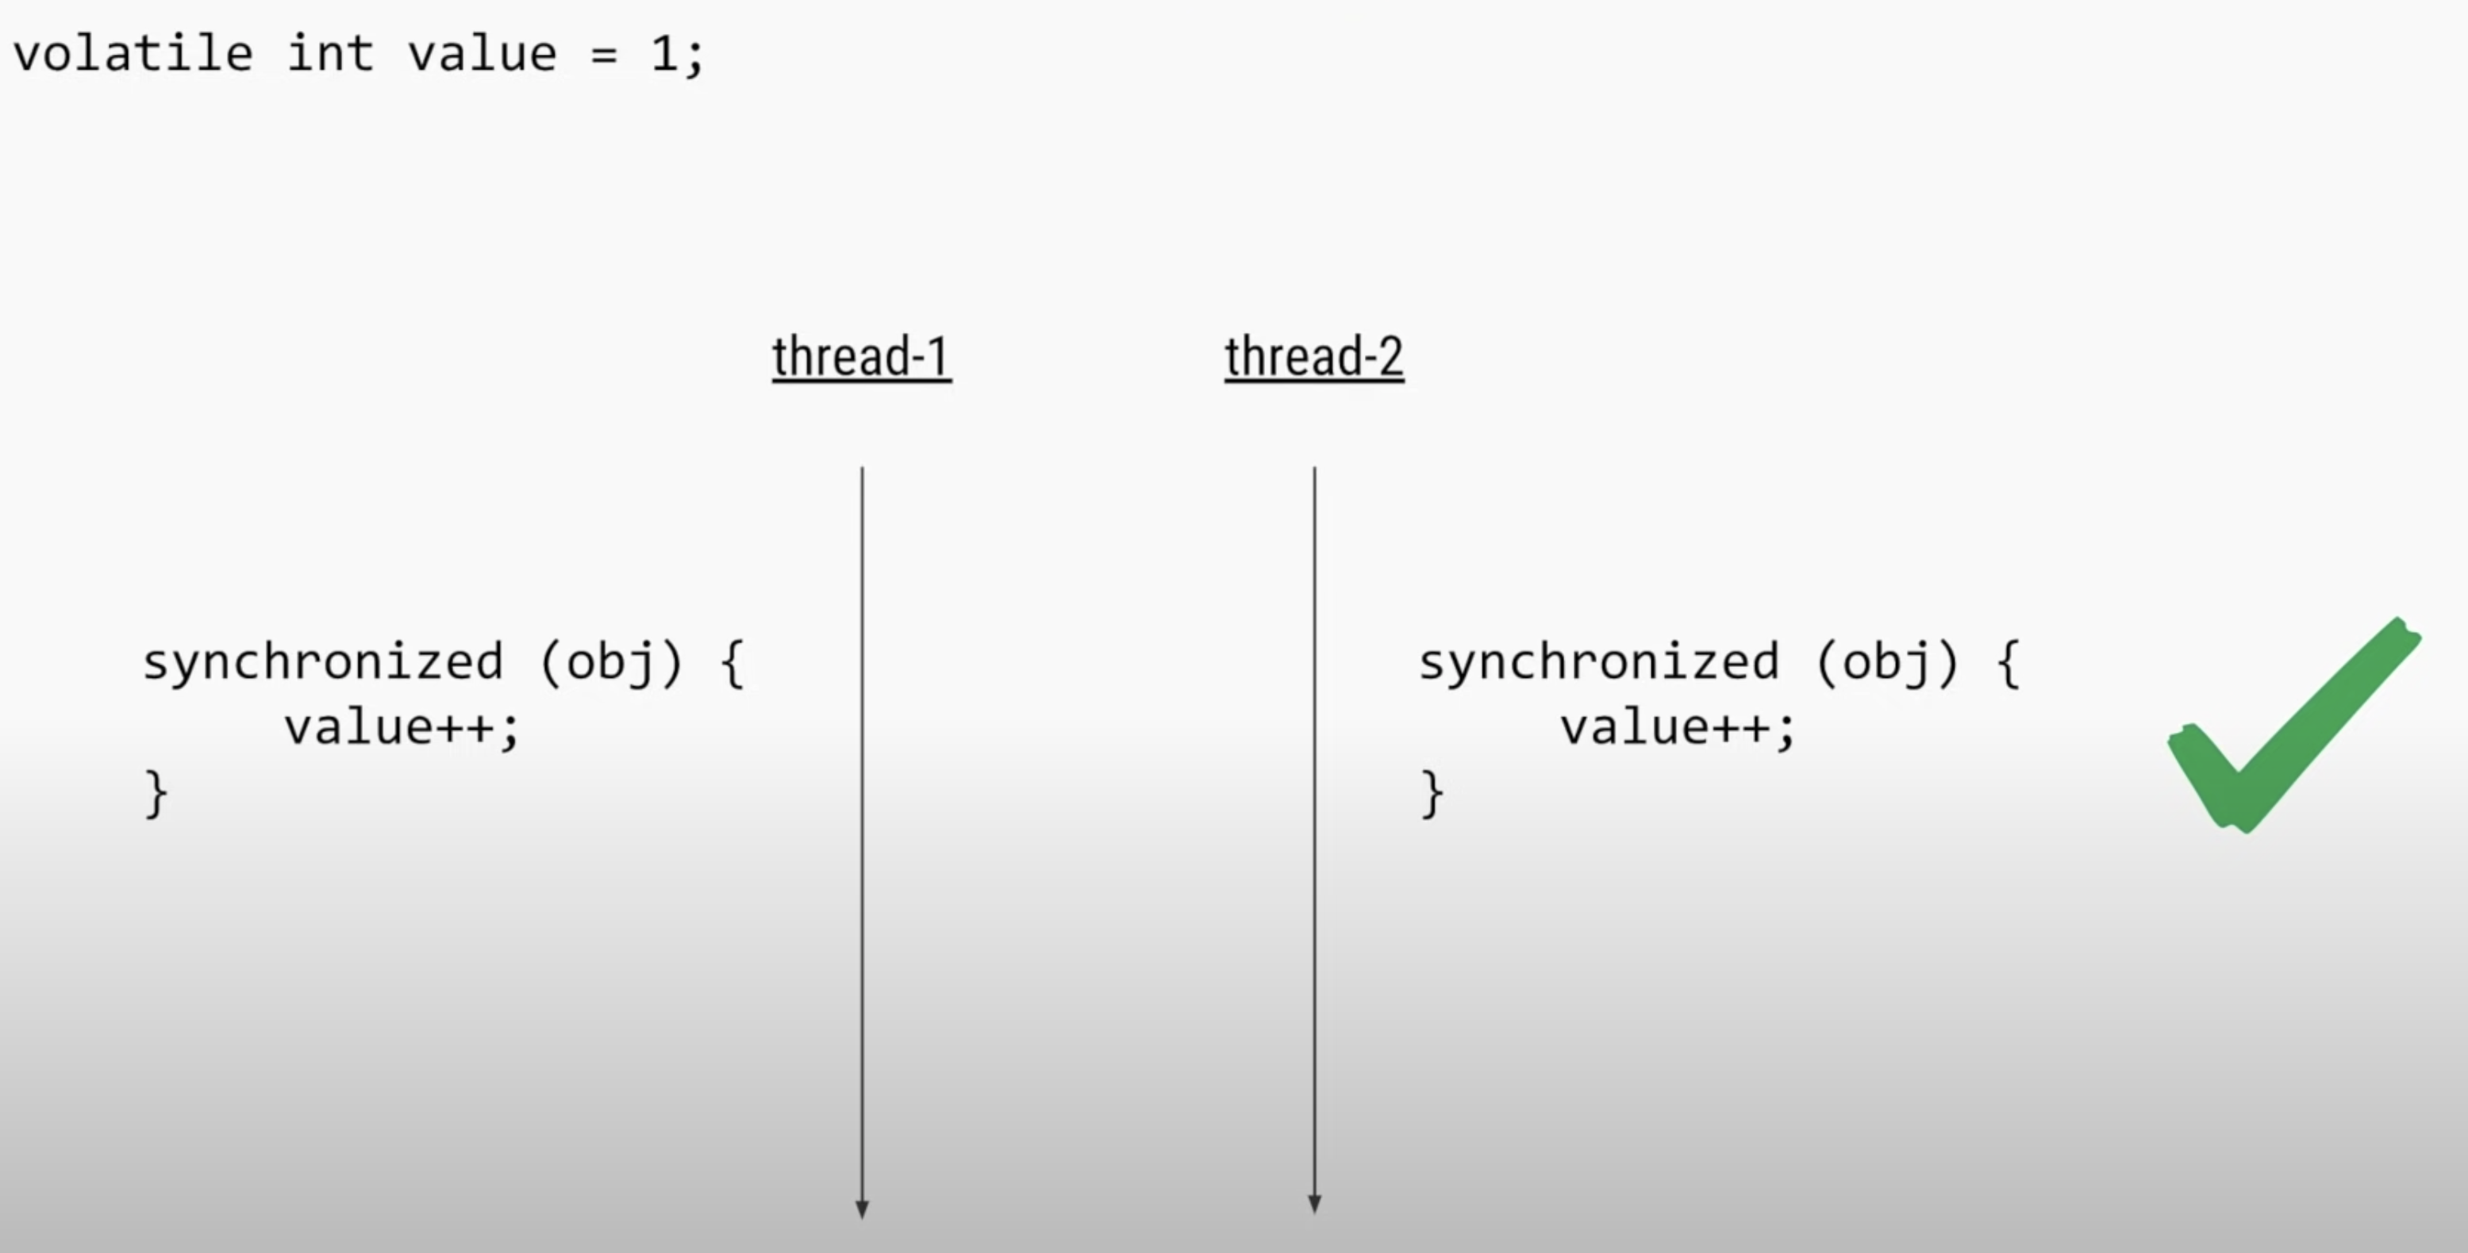
Sol1:

Slide 66
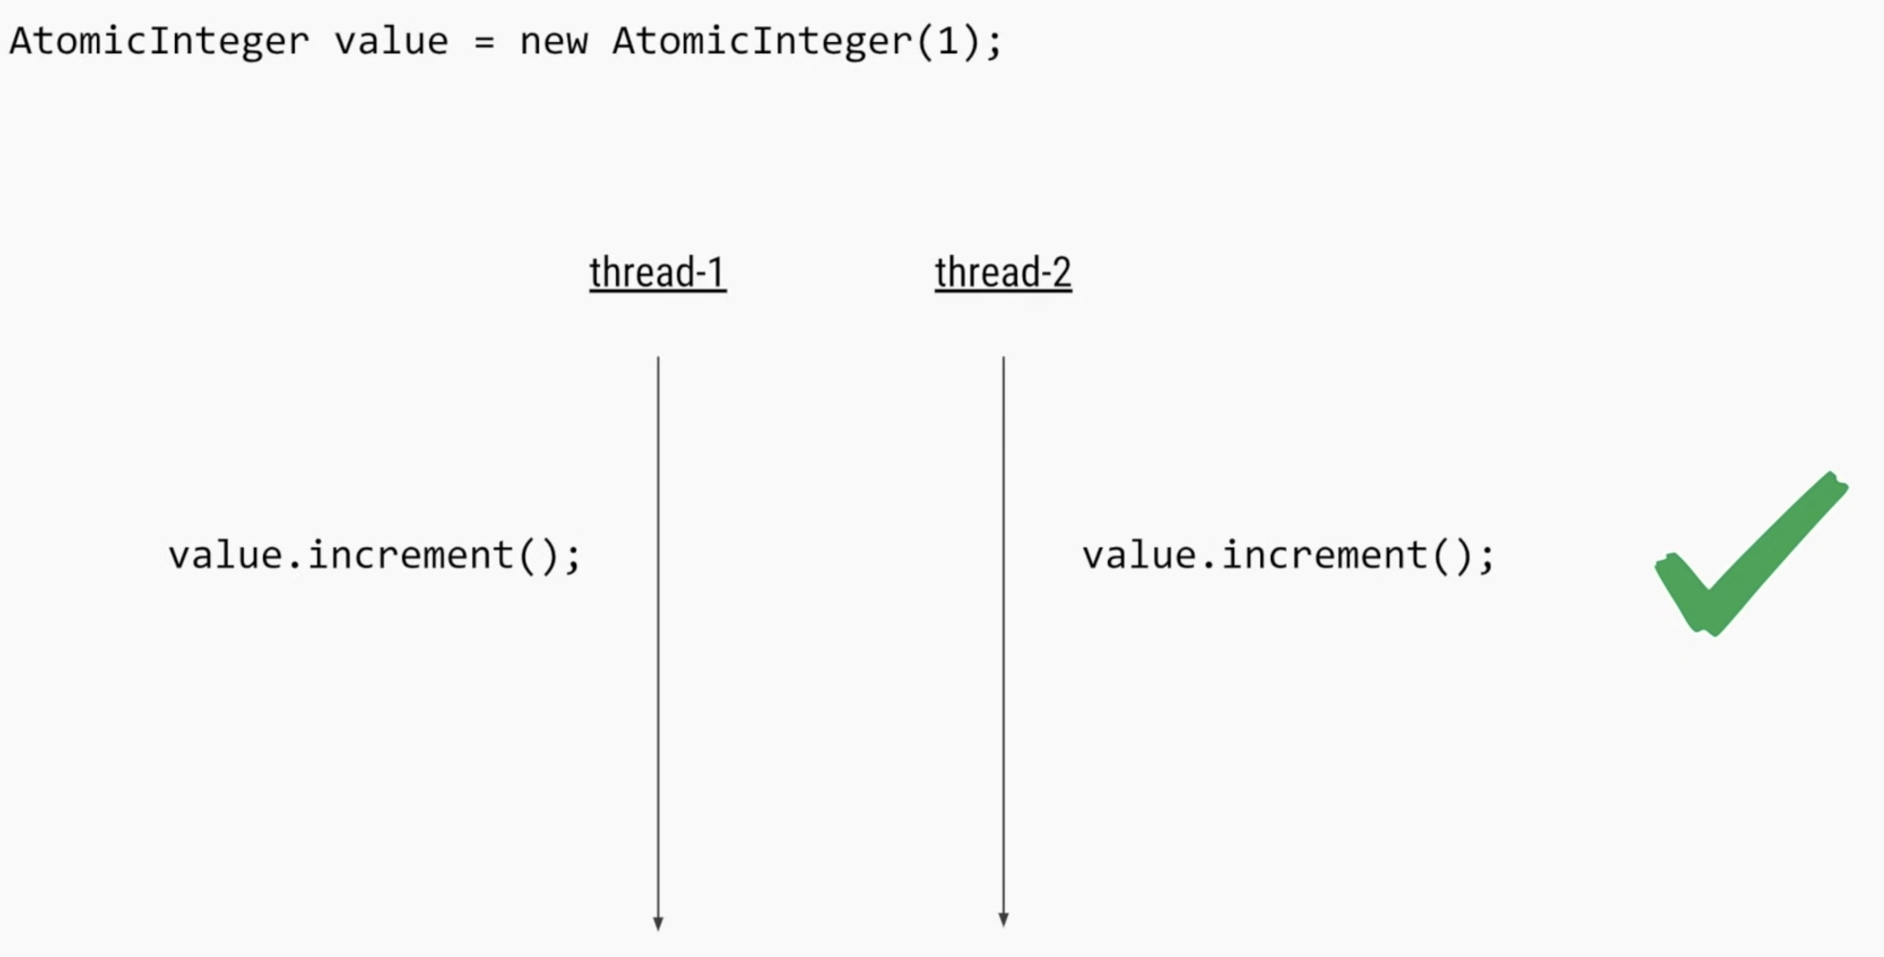
Sol2:

Slide 67
ThreadLocal
Access a variable in multiple places in a thread
Let’s suppose username has to be access in multiple places in the thread

Slide 68
Advance Concurrency API’s

Slide 69

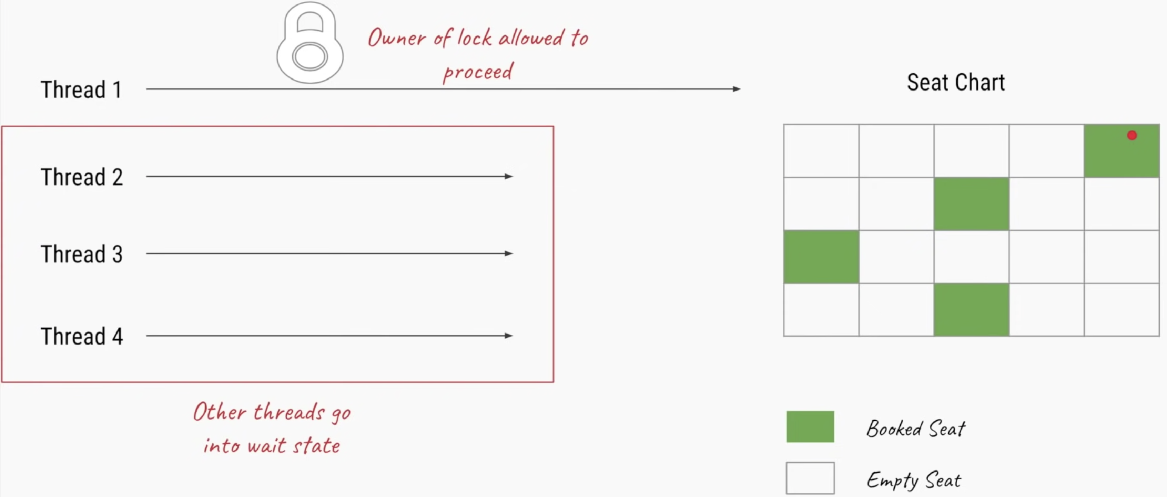
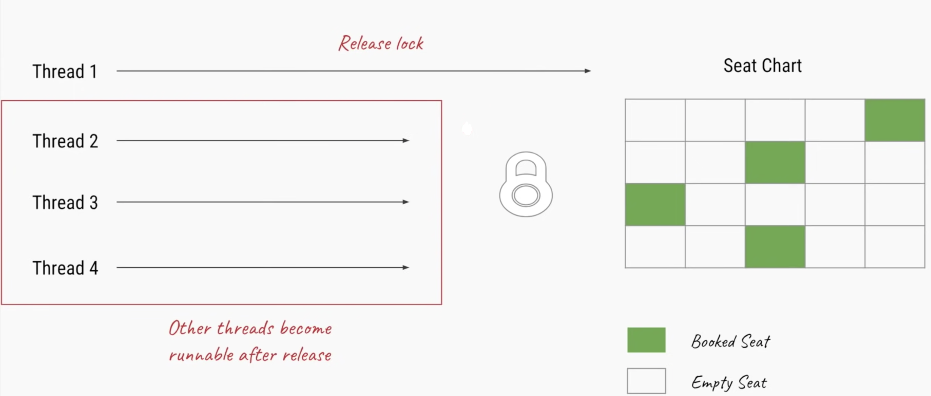
Requirement
1
2
3

Slide 70
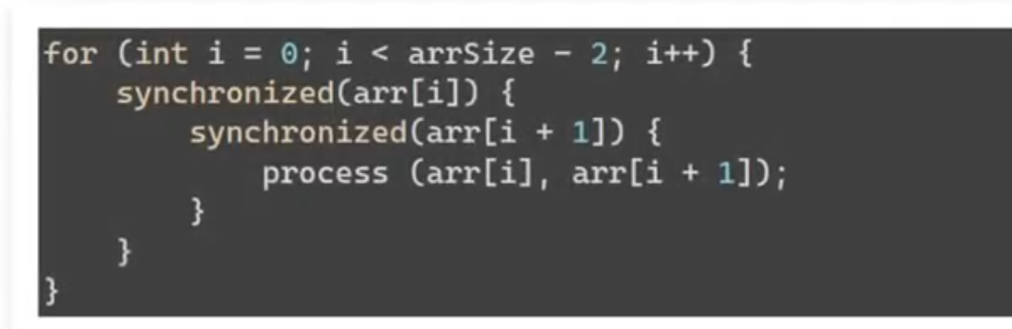
Unstructured Locks
Synchronized keyword –
Structure locks ,
Acquire and release handle for you (implicit)
Nesting possible
Sometimes, nesting might not work
Example

Slide 71
Solution:
Lock interface
https://docs.oracle.com/javase/8/docs/api/java/util/concurrent/locks/Lock.html

Slide 72
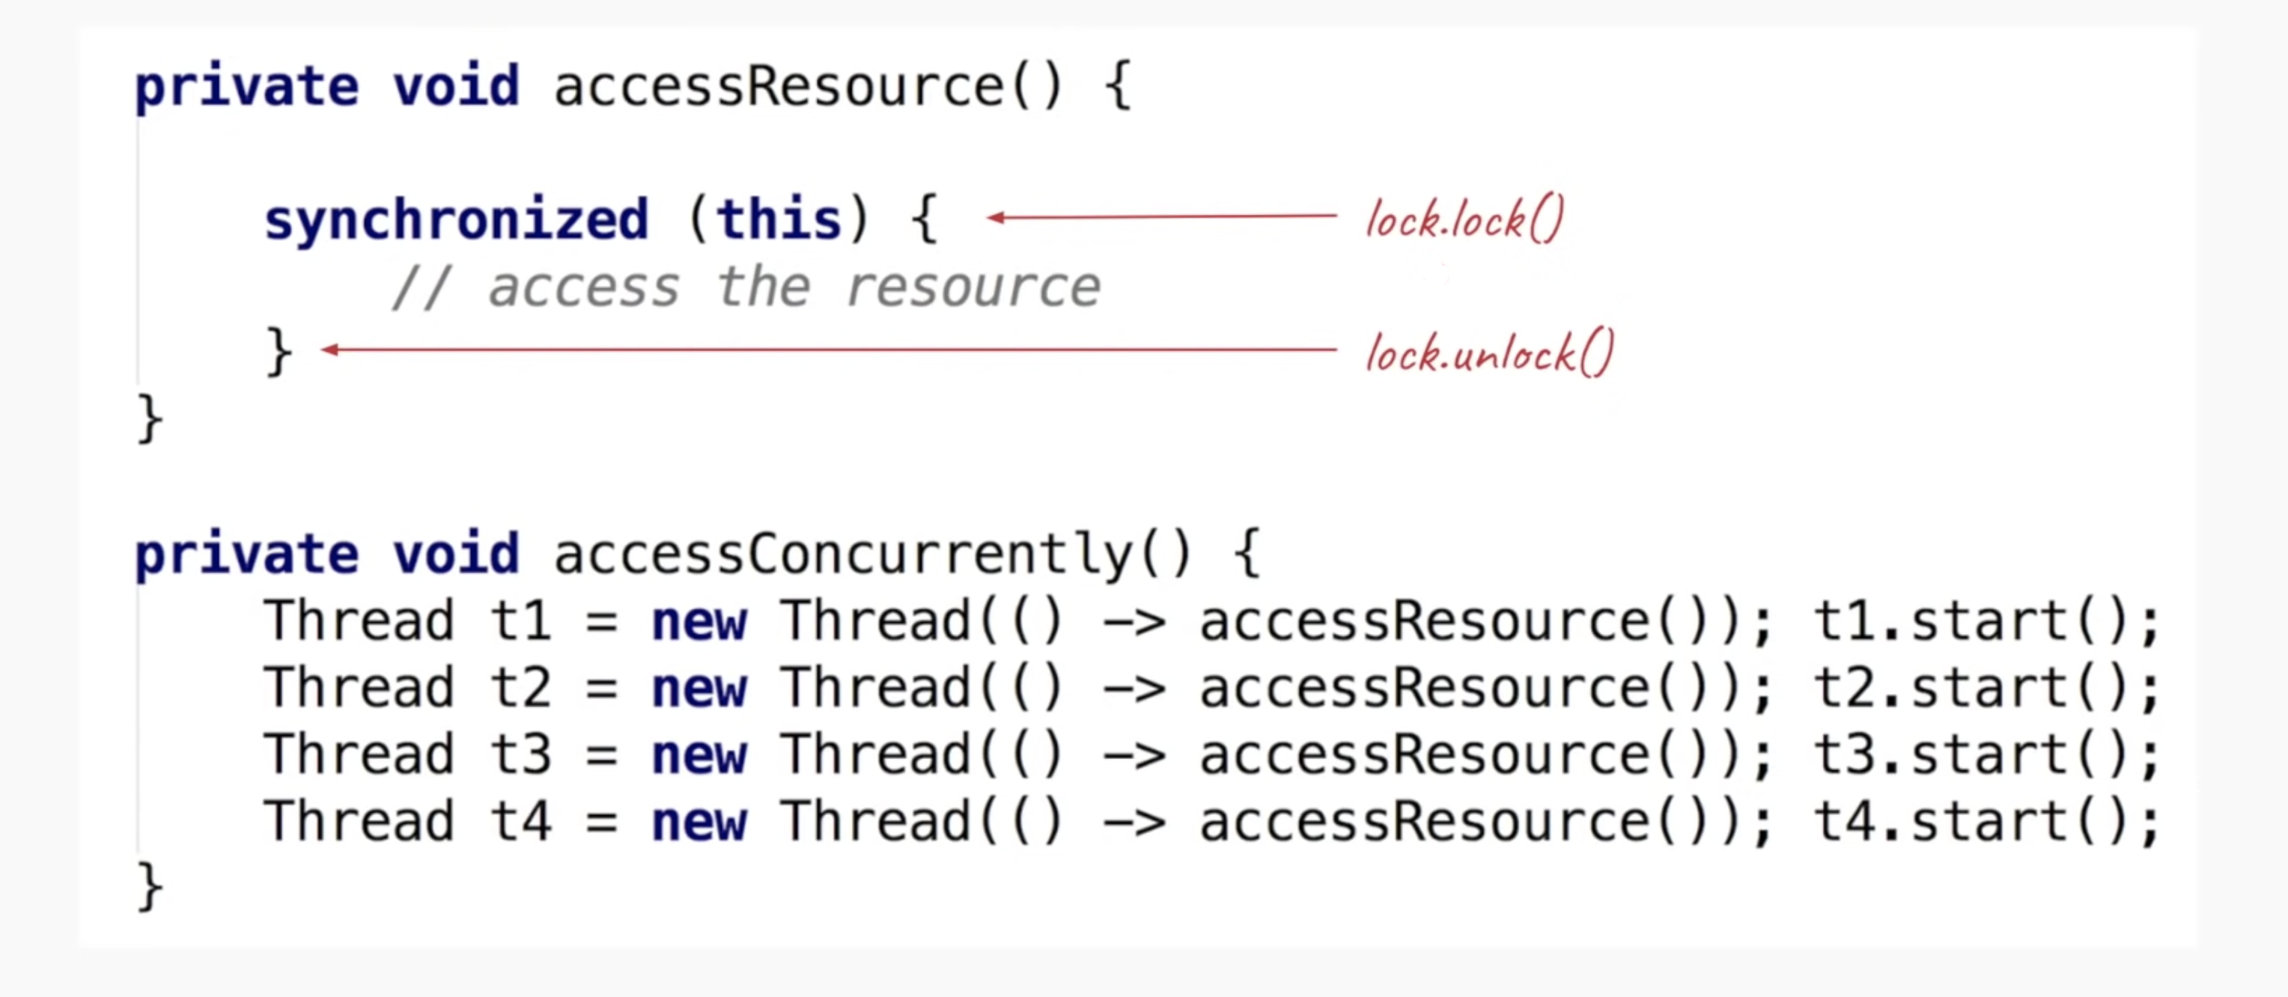
Explicit lock
Ability to tryLock and tryLock(timeout)
Locks allow locking/unlocking in any scope and any order
Implicit lock
Locking and unlocking will be taken care by JVM

Slide 73
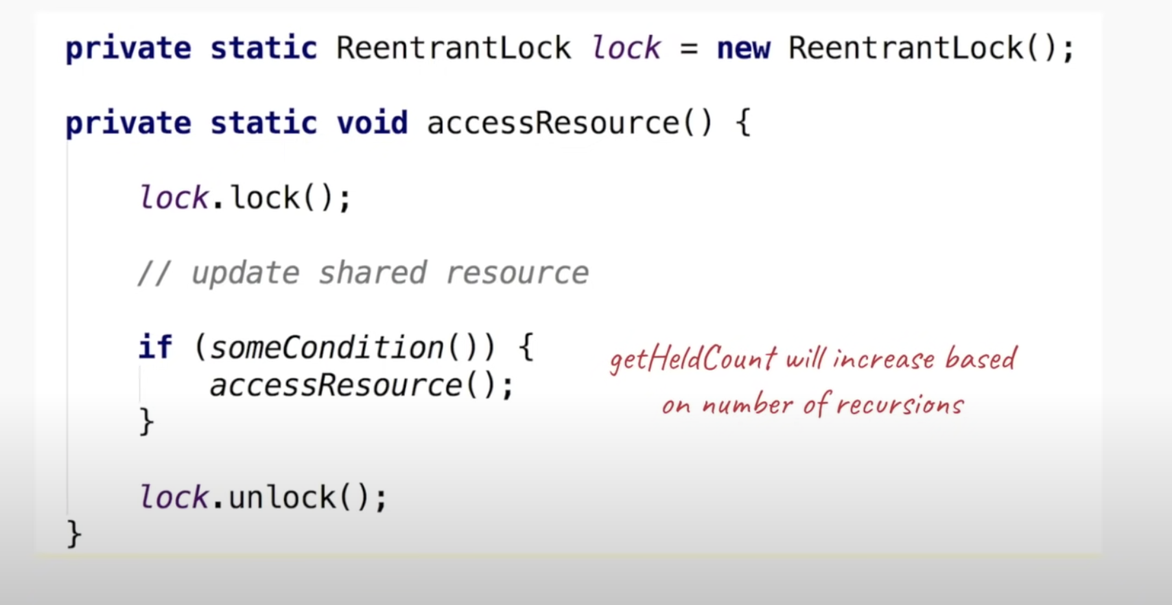

Slide 74
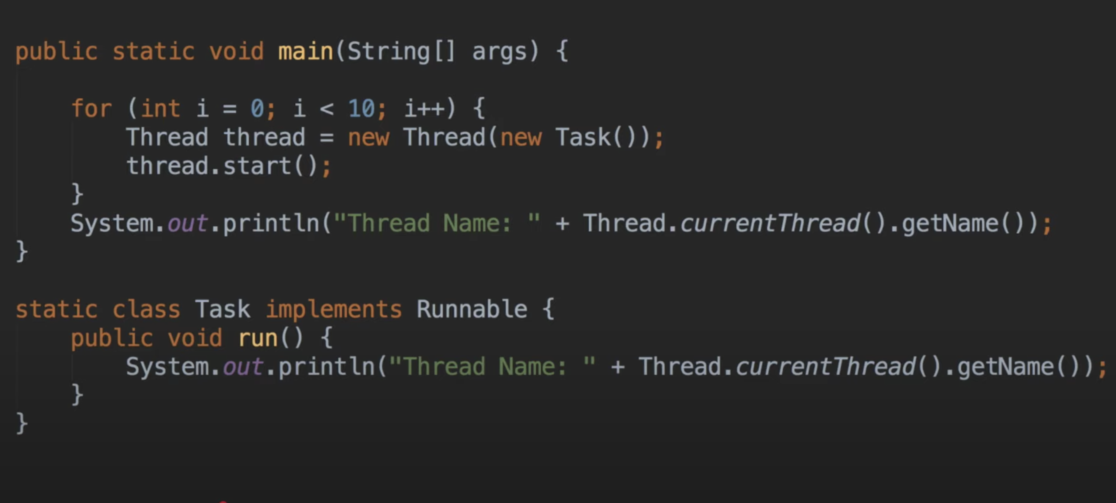
Problem Statement:

Slide 75
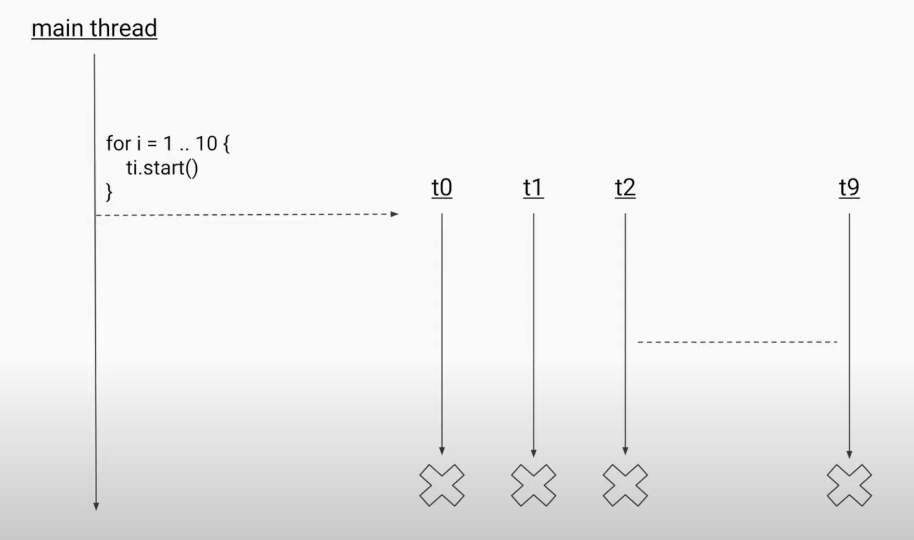

Slide 76
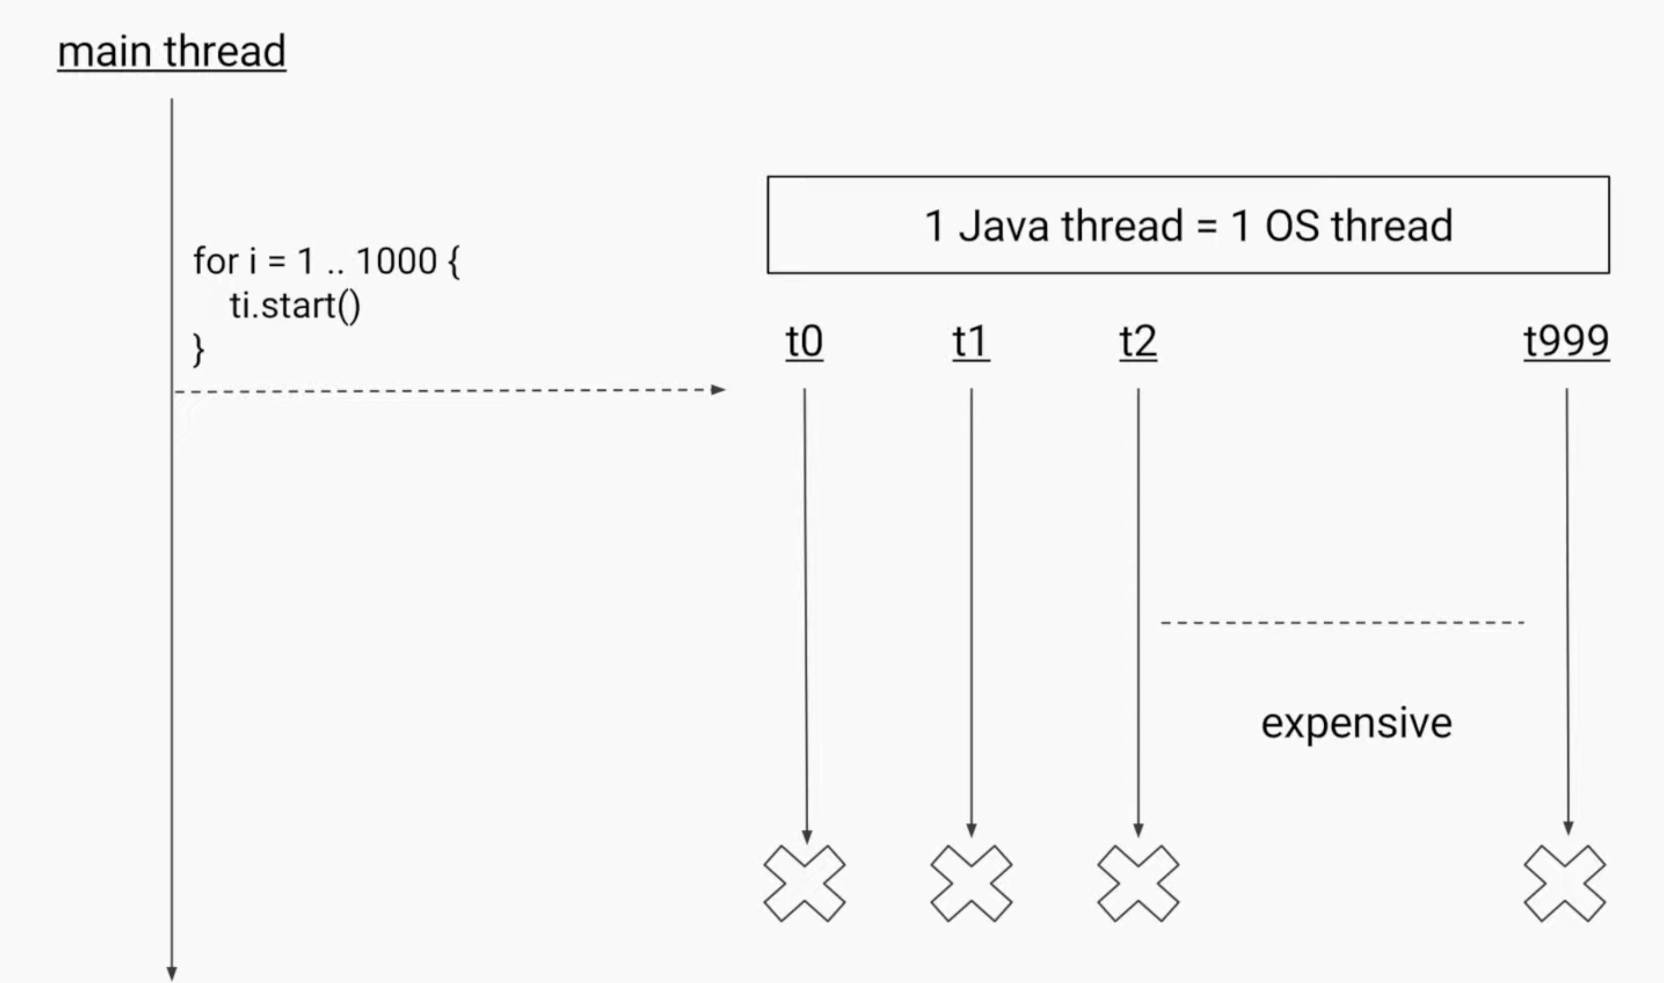

Slide 77
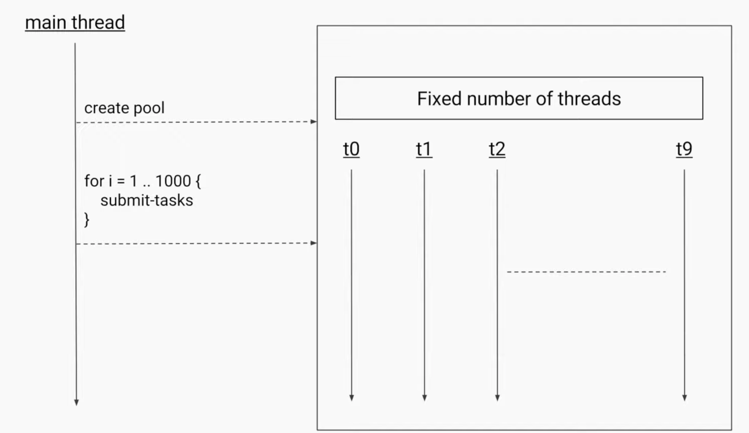
Solution : Create a Pool

Slide 78
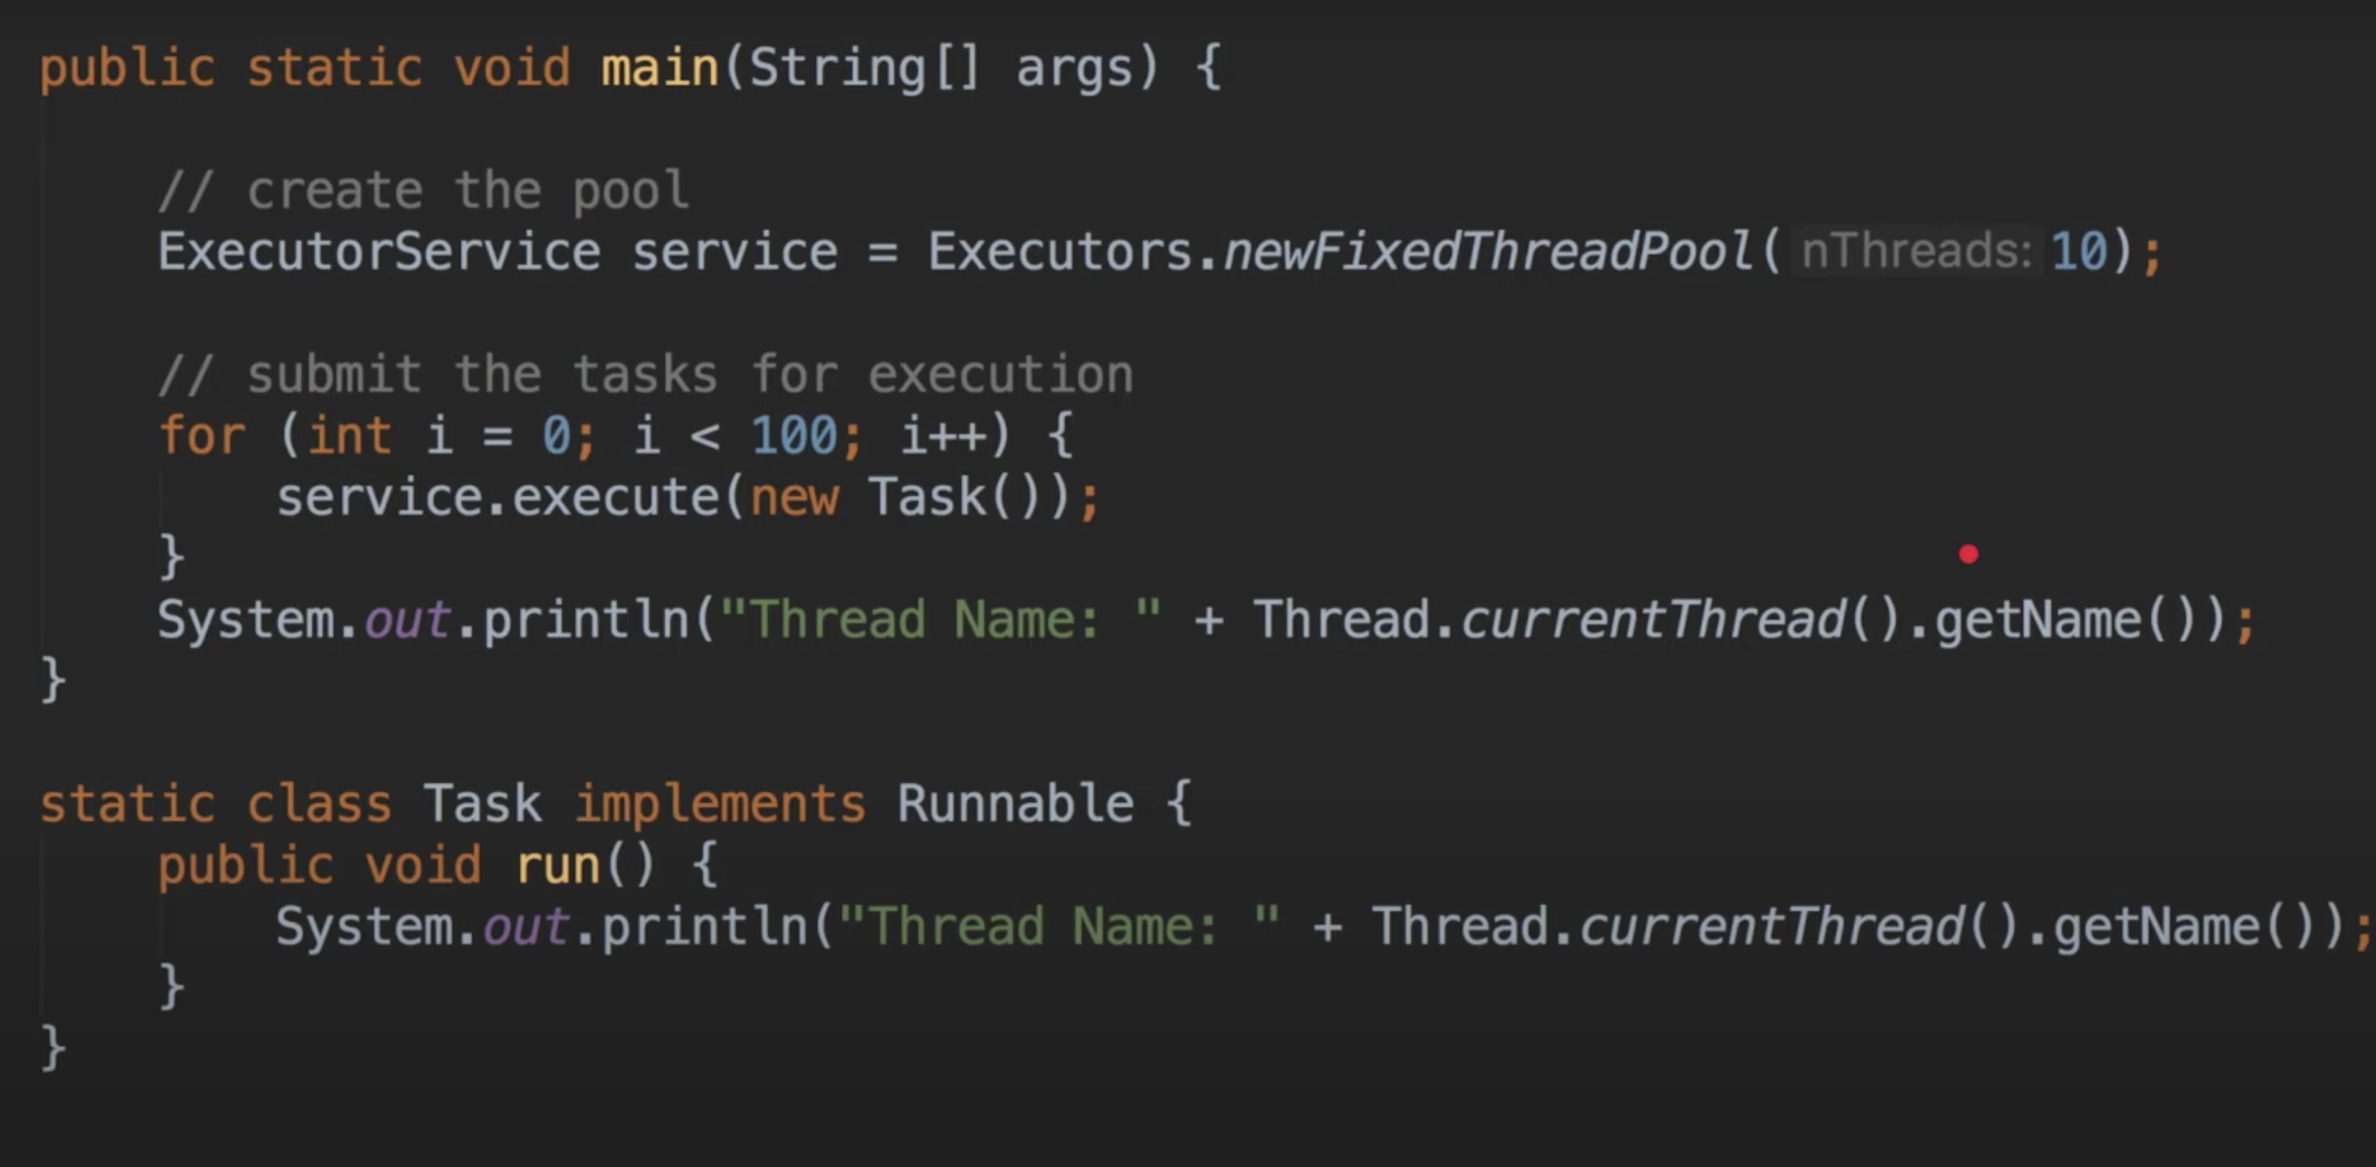
h

Slide 79
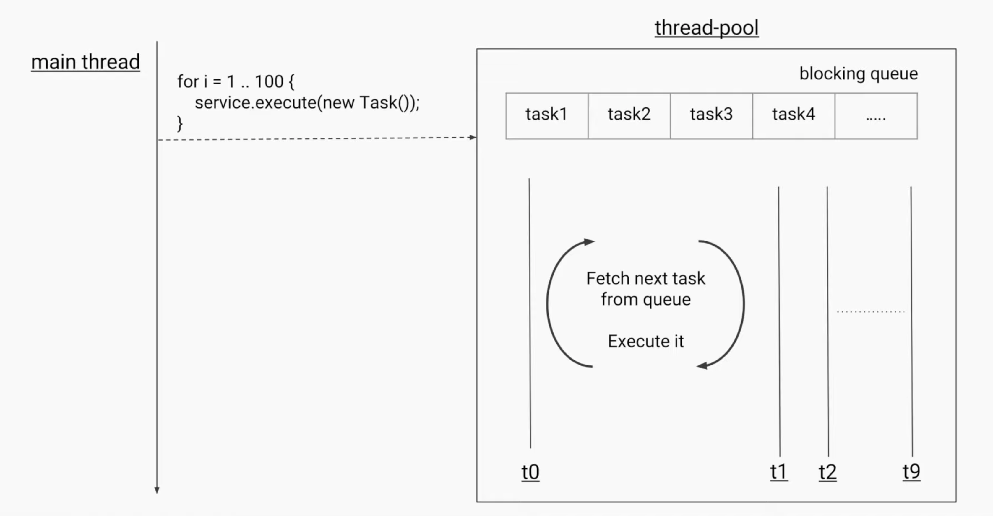
Fixed Thread Pool

Slide 80
Executor service
Day5:
High level threading API for tasks
Manages runnables for you
Motivation: Thread creation is resource insentive so reuse threads
Thread Pool : Fixed no.of instances

Slide 81
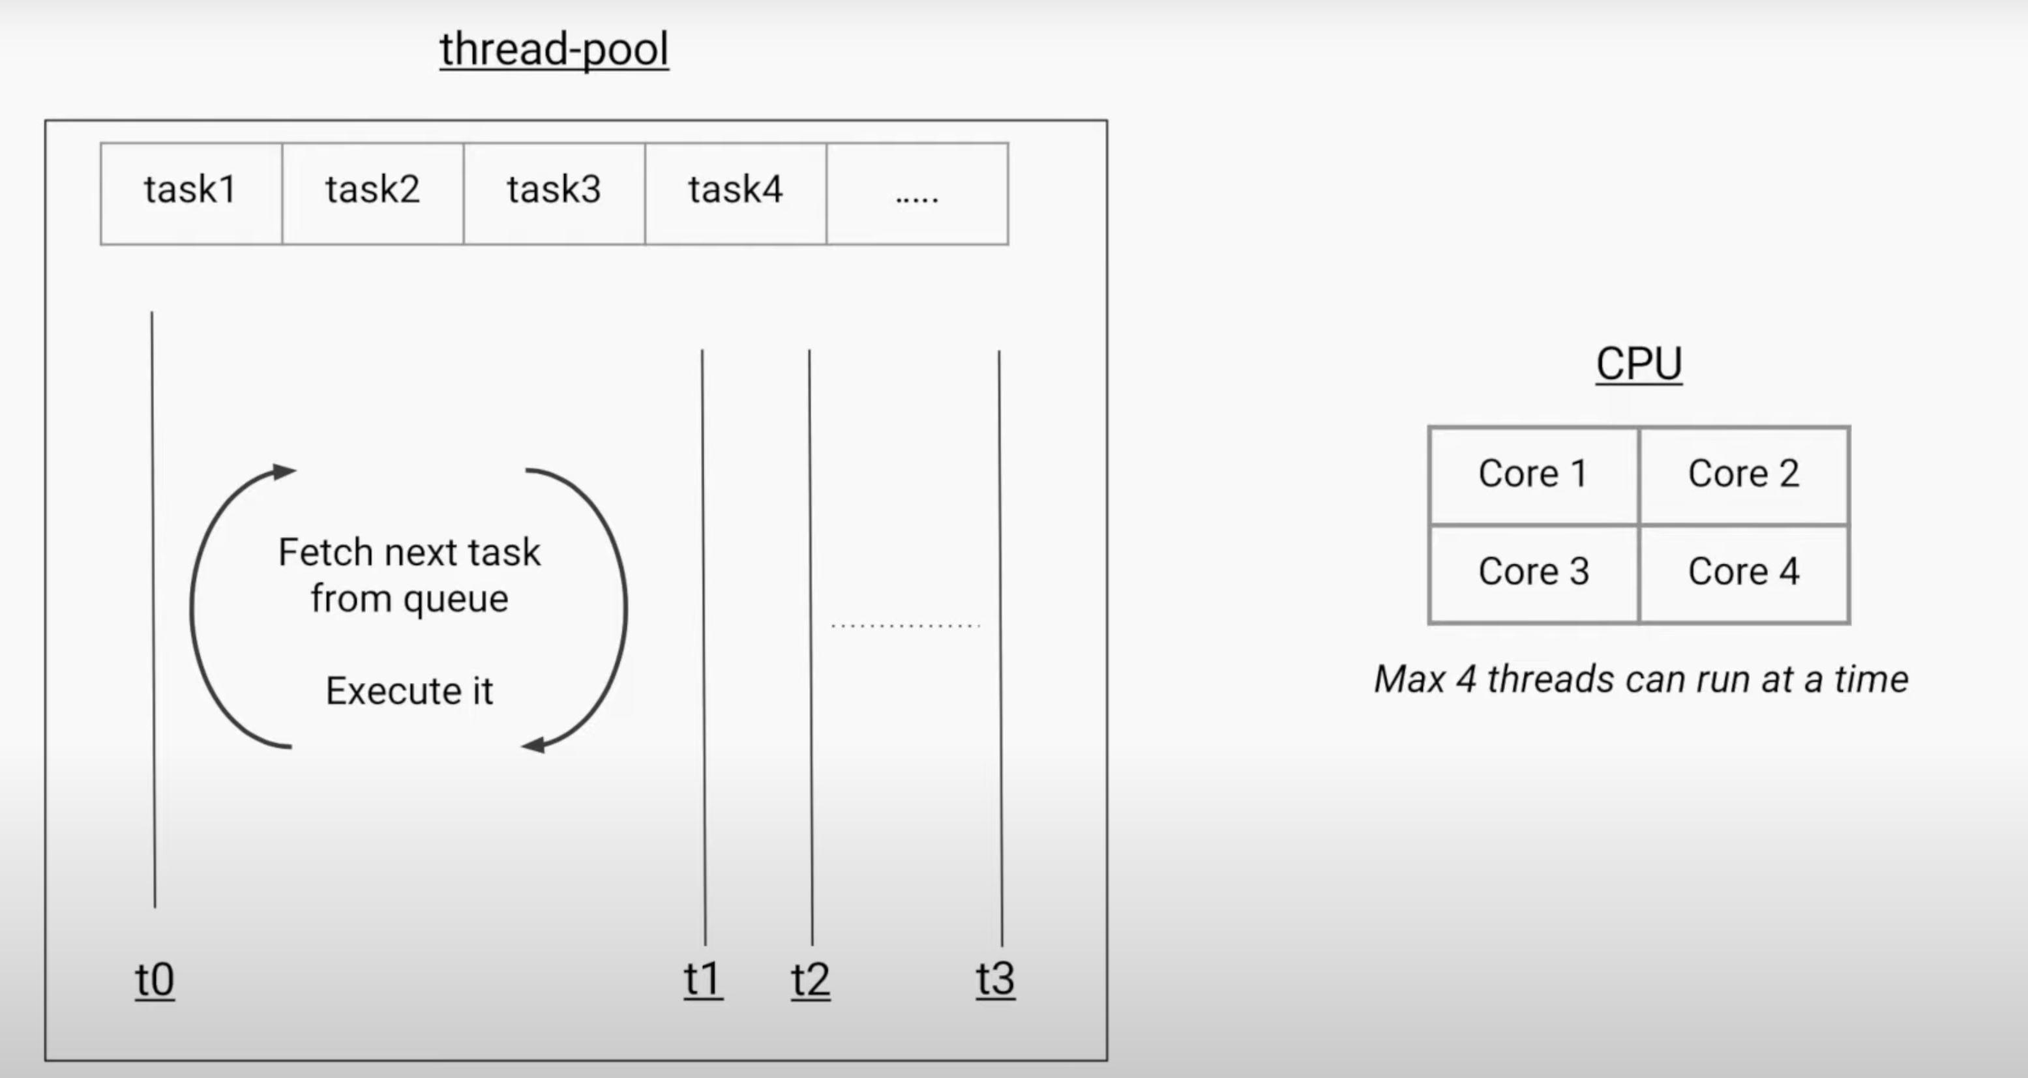
Ideal Thread Pool Size ?

Slide 82
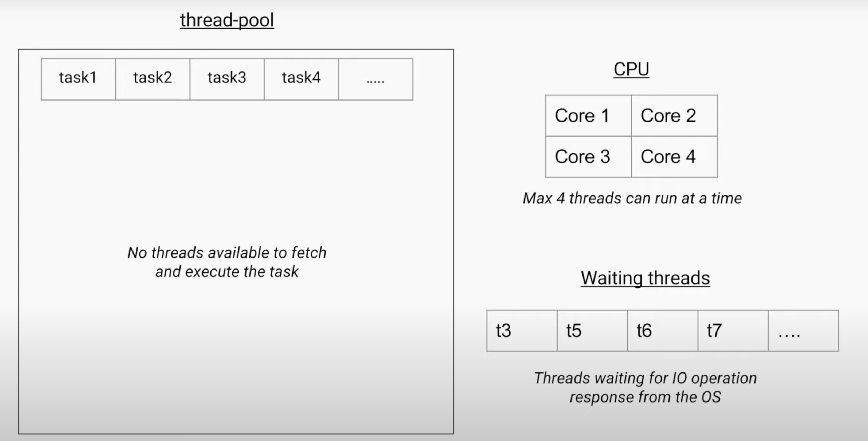

Slide 83
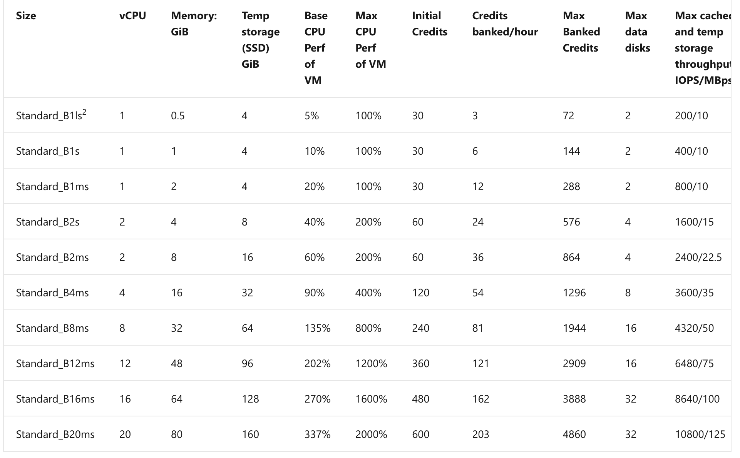

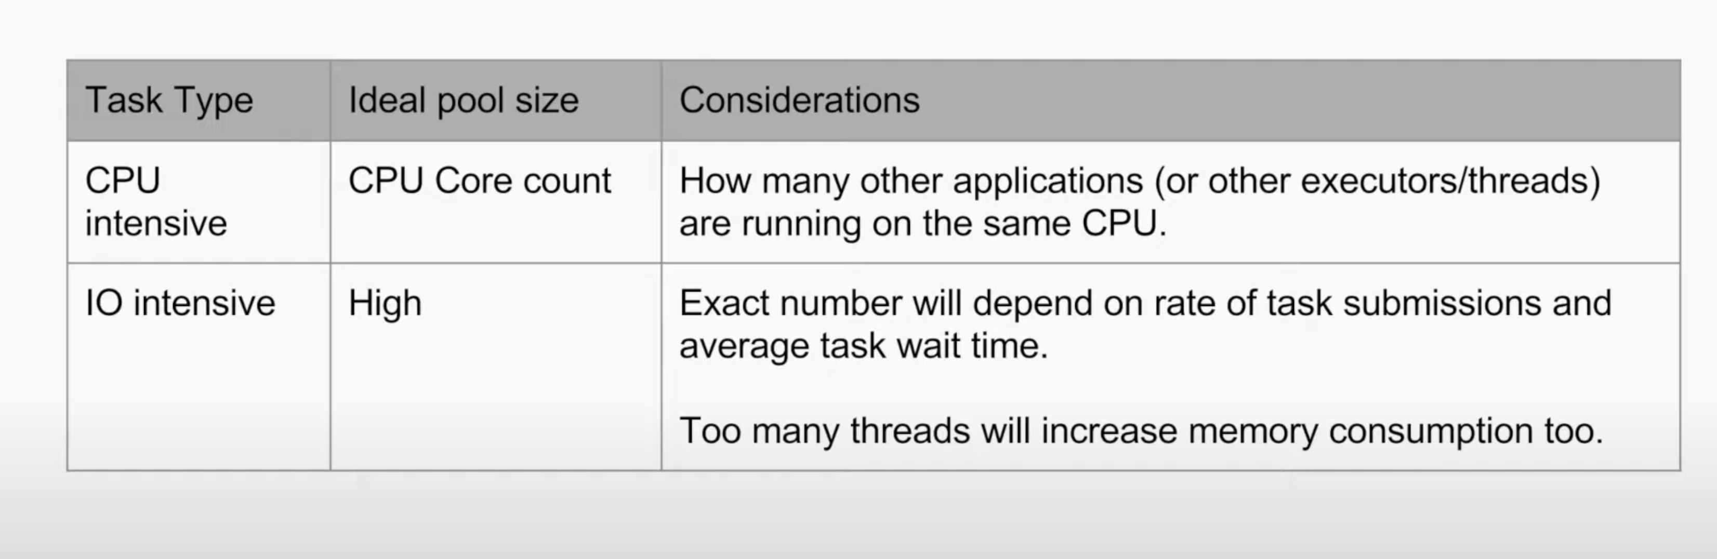
Azure B-Series

Slide 84
Types of Pools
Fixed Thread Pool
Cached Thread Pool
Scheduled Thread Pool
Single Thread Executor

Slide 85
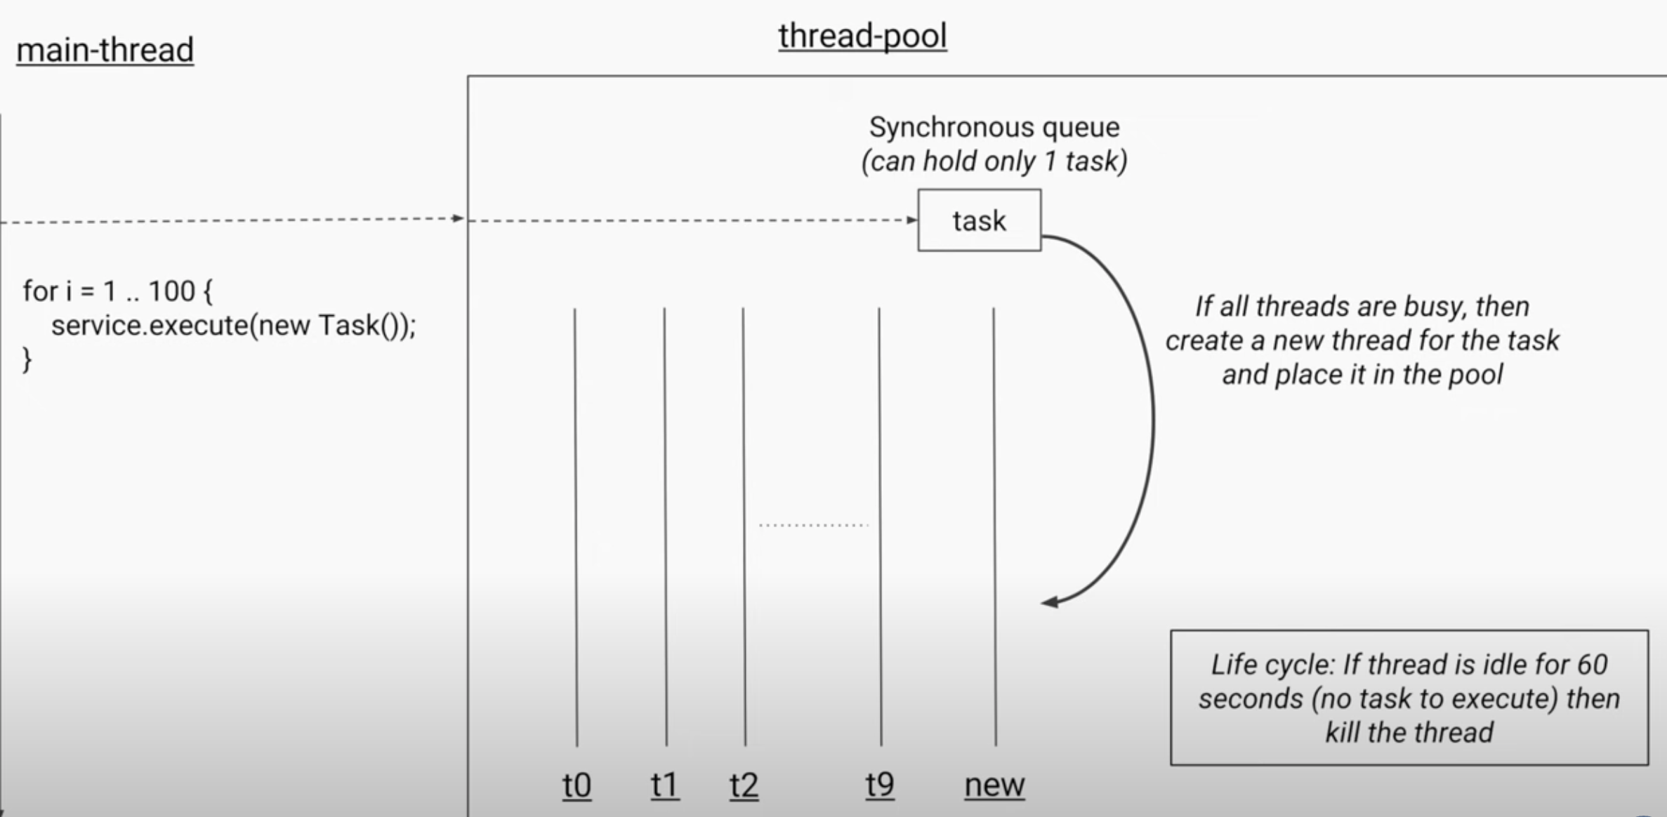
Cached Thread Pool

Slide 86


Slide 87

Scheduled Thread Pool

Slide 88


Slide 89

Single Thread Executor

Slide 90

What if I want to return from runnable ?

Slide 91


Slide 92


Slide 93


Slide 94


Slide 95


Slide 96
Completable Feature – In java 8 Introduced
Day6:
Perform possible asynchronous(non-blocking) computations and trigger dependent computations which also be asynchronous

Slide 97



Slide 98

Requirement ?
https://thepracticaldeveloper.com/differences-between-completablefuture-future-and-streams/

Slide 99

Under standing Fork-Join Pool
Very similar to executor service
1. Tasks Producing sub-tasks
Forking
Joining

Slide 100



1
3
2

Slide 101


2.Per thread queuing & Work stealing
1
2

Slide 102


Slide 103

Final picture of fork-join pool

Slide 104


Ways to submit tasks
Ones same's as Executor service

Slide 105

Semaphores – “Permit-based” access
Locks –> Only one thread at a time
Semaphores -> Limited no.of Threads at a time
At most only three Nth prime number calculations happen at a time ?
We want to limit that .
Total permits: 3

Slide 106


